Slide 1
Recent CMS flavor physics results
Sergey Polikarpov
NRNU MEPhI, LPI RAS
MISP 2022 Dubna 28 July 2022

Slide 2
Outline
Why B→μμ? + previous results
CMS experiment
Analysis strategy
Backgrounds
Event selection
Results

Slide 3
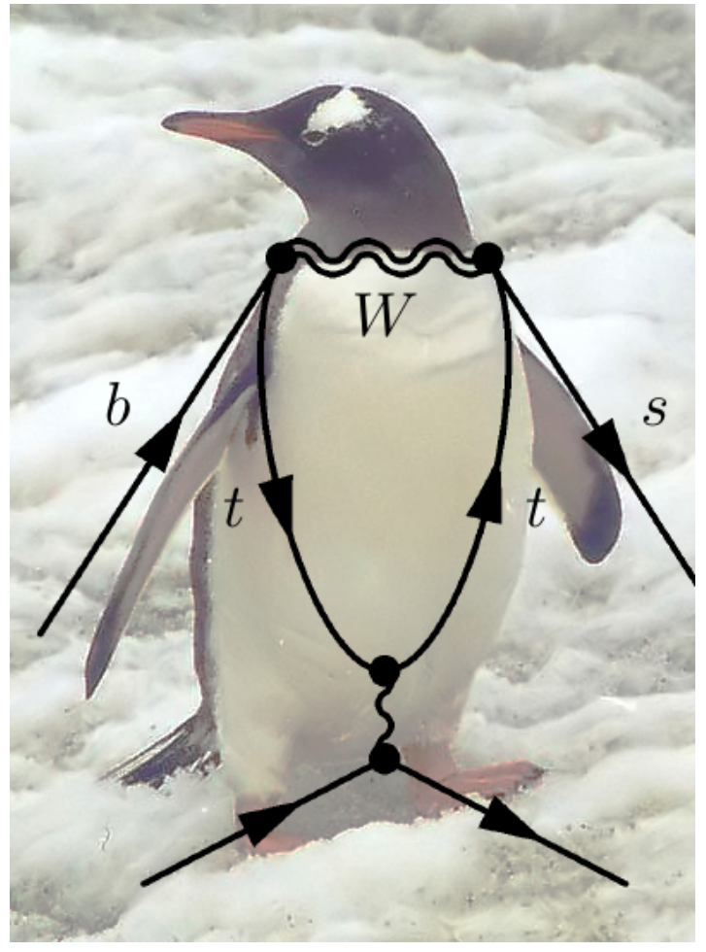
Why B→μμ ?
The branching fractions of B⁰ and B⁰_{s}→μμ decays are predicted precisely in the SM and are very low
The decays also present
clean experimental signature
Any deviations from SM would
present a sign of NP
μ
μ

Slide 4
B→μμ: previous results
ATLAS, CMS, LHCb have their results from partial Run-2:
ATLAS, 2015+2016 data, combined with Run-1, December 2018
CMS, Run-1 + 2016 data, October 2019
LHCb, Run-1 + 2016 data, March 2017
Statistical Combination CMS+ATLAS+LHCb was performed in 2020 (not published)
CMS-PAS-BPH-20-003
ATLAS-CONF-2020-049
LHCb-CONF-2020-002
Compatible with SM within 2.1σ

Slide 5
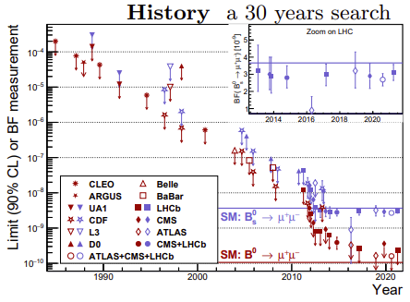
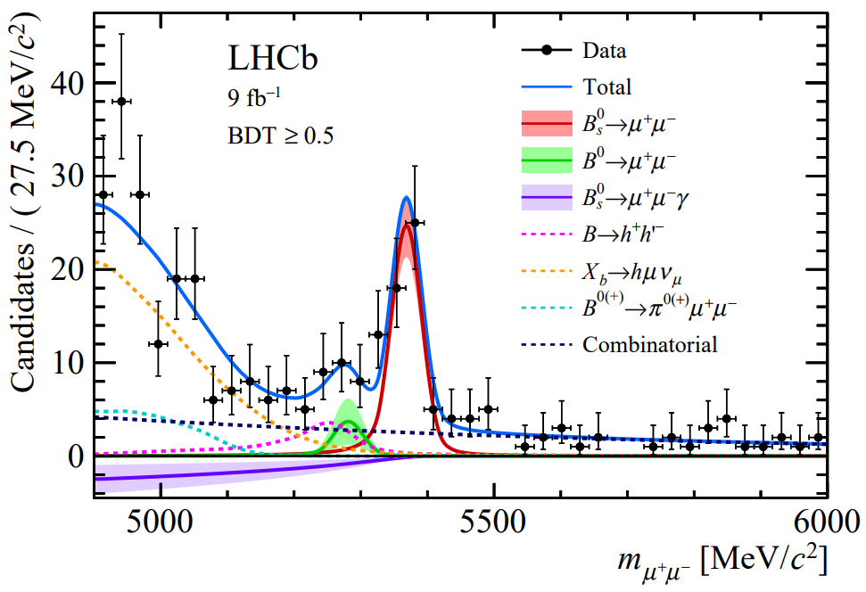
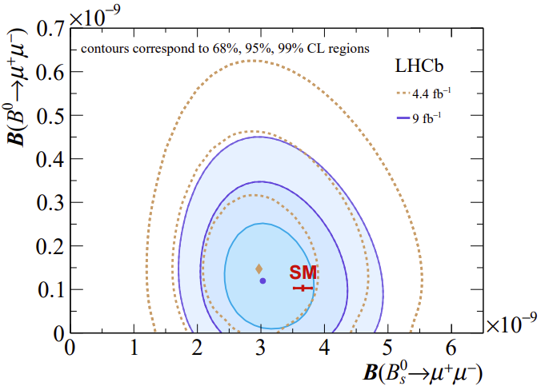
B→μμ
The latest results [until ~2 weeks ago]
on 30-year-long search are from LHCb,
August 2021, Full Run-1 + Run-2
B⁰_{s} >10σ, B⁰ ~1.7σ
Consistent with SM
at 95% CL
LHCb-PAPER-2021-008, Phys.Rev.D105(2022)012010
LHCb-PAPER-2021-007, Phys.Rev.Lett.128(2022)041801
Papers also reports effective lifetime and B⁰_{s} →μ⁺μ⁻γ

Slide 6
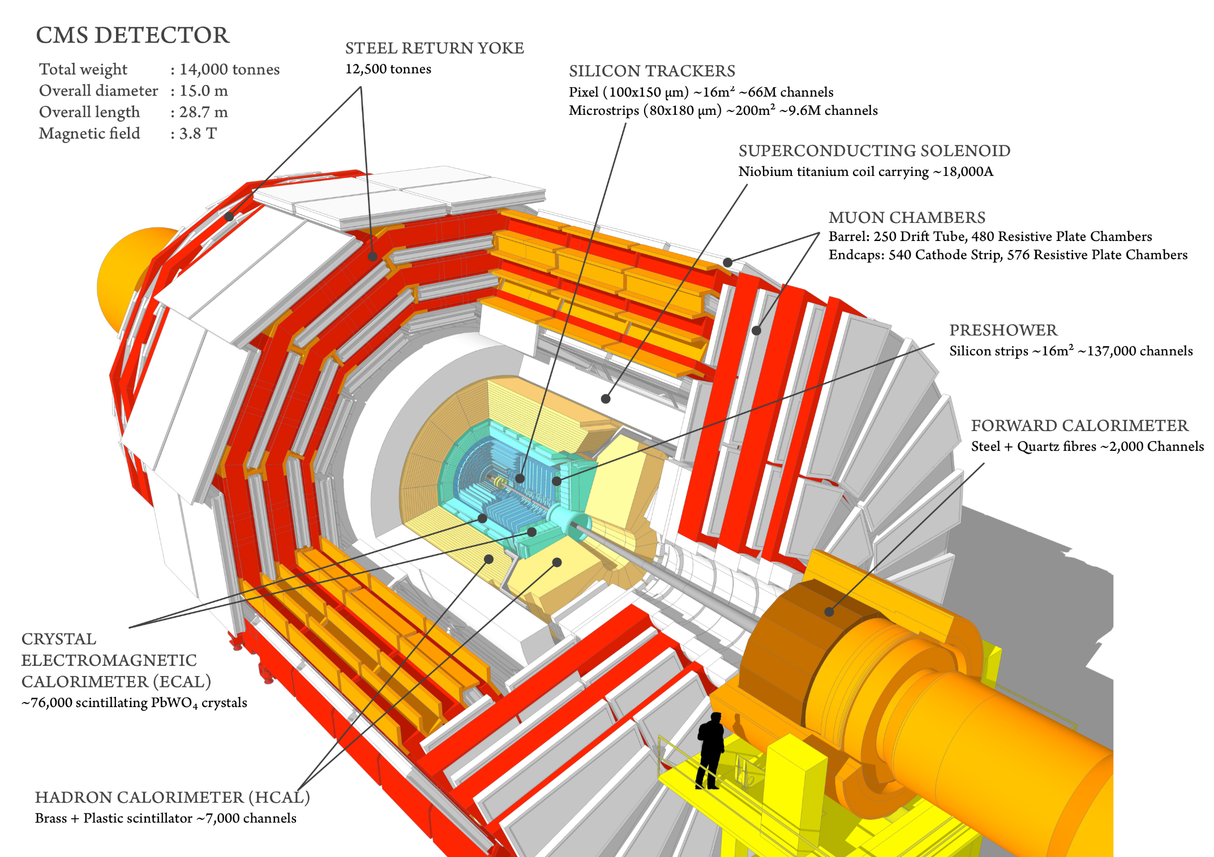
CMS experiment

Slide 7
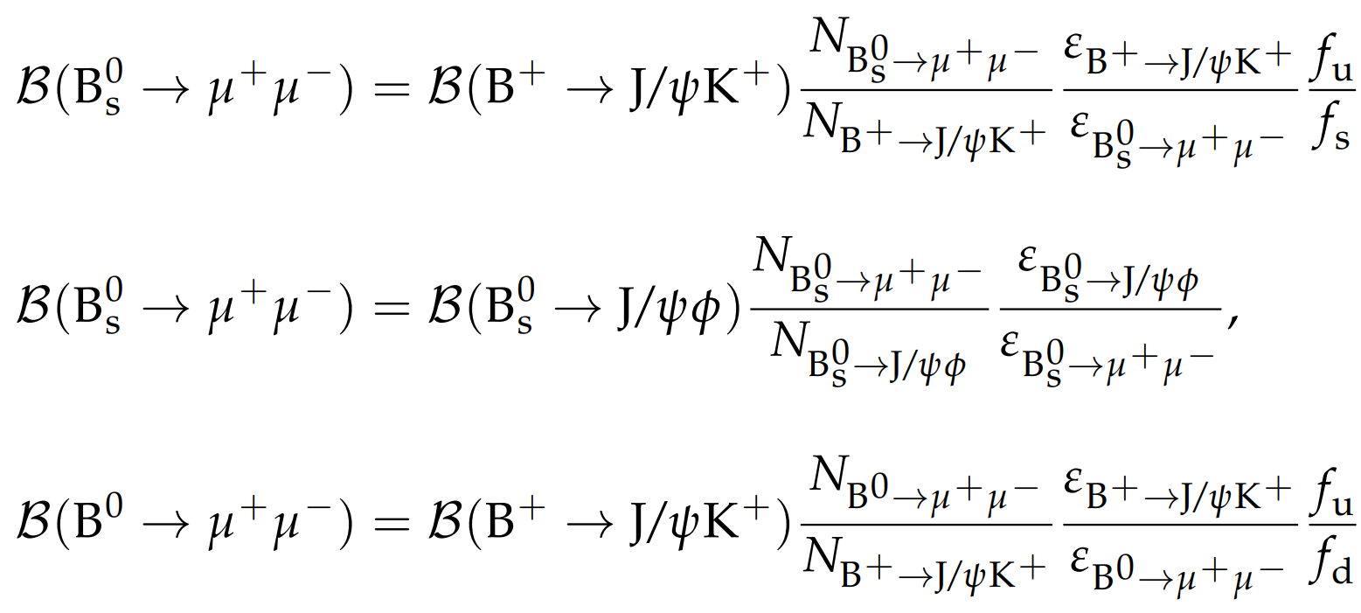
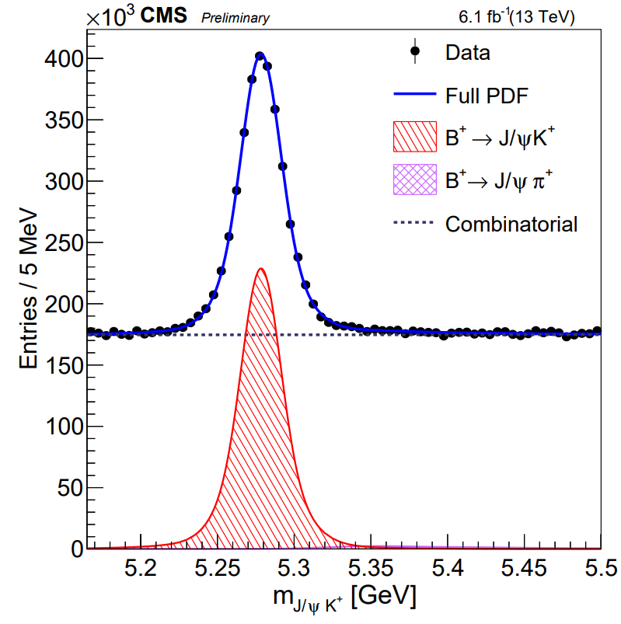
Analysis strategy
External input, ratio of B⁰_{s} and B⁺ production xsections
(or
)
1
σ(B⁺)=σ(B⁰)
Branching fractions are measured using the normalization channel B⁺→J/ψK⁺
Most systematic uncertainties cancel in the ratio
Data are split into 16 = 4*2*2 categories:
4 data-taking periods (2016a, 2016b, 2017, 2018)
2 |η_{μ}| (muon pseudorapidity) regions
2 ranges of MVA discriminator (0.9<MVA<0.99 and 0.99<MVA<1) - see later
Fitting separately low- and high-sensitivity regions and combining the results yields in a more precise result

Slide 8
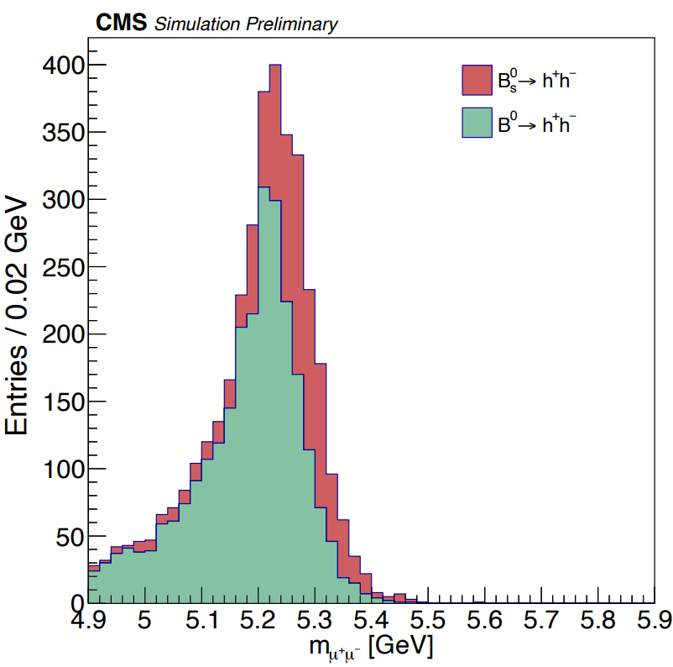
Backgrounds
Partially-reconstructed decays
Combinatorial background
μ⁻
μ⁻
γ
μ⁺
μ⁺
μ⁻
B
B
—ν_{μ}
—B
ν_{μ}
μ⁺
K⁻
π⁺
Decays in-flight of pions and kaons from B→hh,
resulting in double muon fakes.
The most complicated bkg! Looks like signal
Reduced with MVA-based muon identification
detecting imperfections in muon trajectory
Calibrated in data with φ(1020) → K⁺K⁻ and K⁰_{S} →π⁺π⁻ decays
Rate is ~comparable to B⁰→μμ, and the shape is close to B⁰→μμ
B

Slide 9
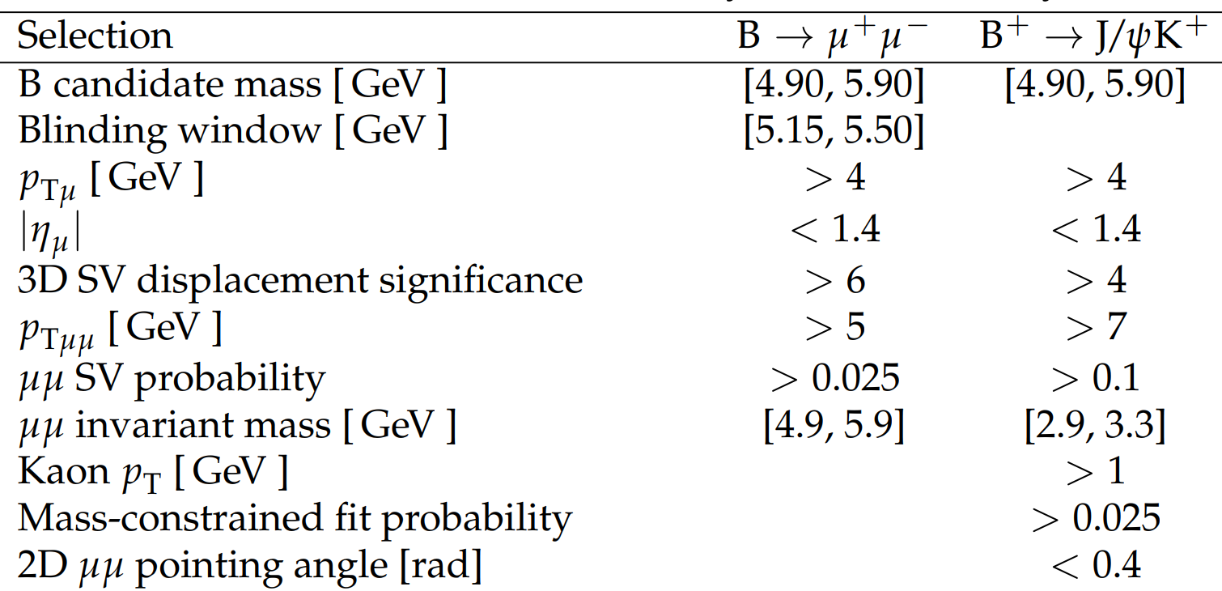
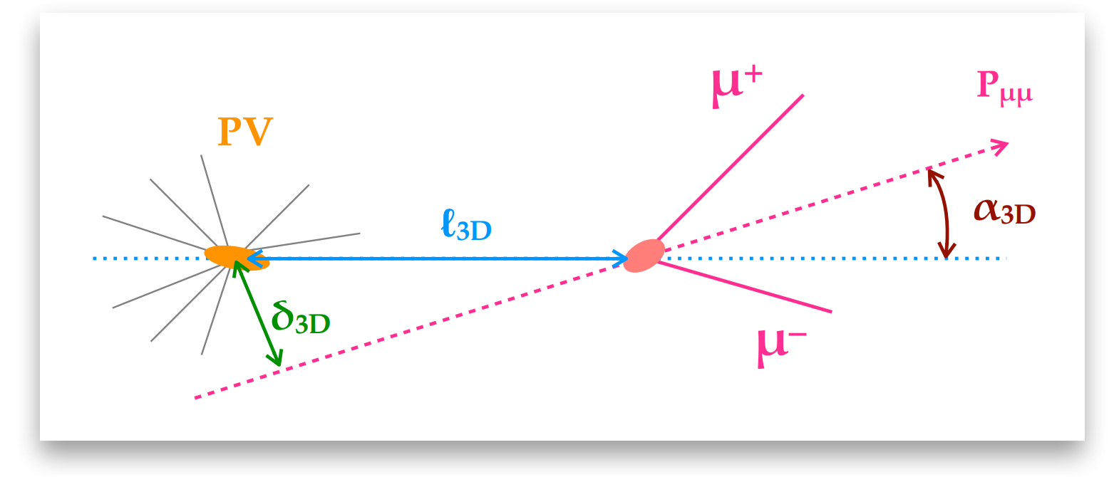
Event selection
Full Run-2 data (140 fb⁻¹)
Loose pre-selection before MVA:
Final selection:
MVA trained with XGBoost
(MC for signal, data sidebands for bkg) is
used to suppress dominant backgrounds
Employed variables identify the
distinct topology of B→μμ decays
2D and 3D pointing angles α
2D and 3D impact parameter δ
Flight length l and its significance l/σ_{l}
Dimuon vertex quality
Isolation of muons and the dimuon
Normalization channel B⁺→J/ψK⁺ is used to calibrate MVA with data
p_{T}(K⁺) < 1.5 GeV and rescaled l/σ_{l} make a bridge between B→μ⁺μ⁻ and B⁺→J/ψK⁺

Slide 10
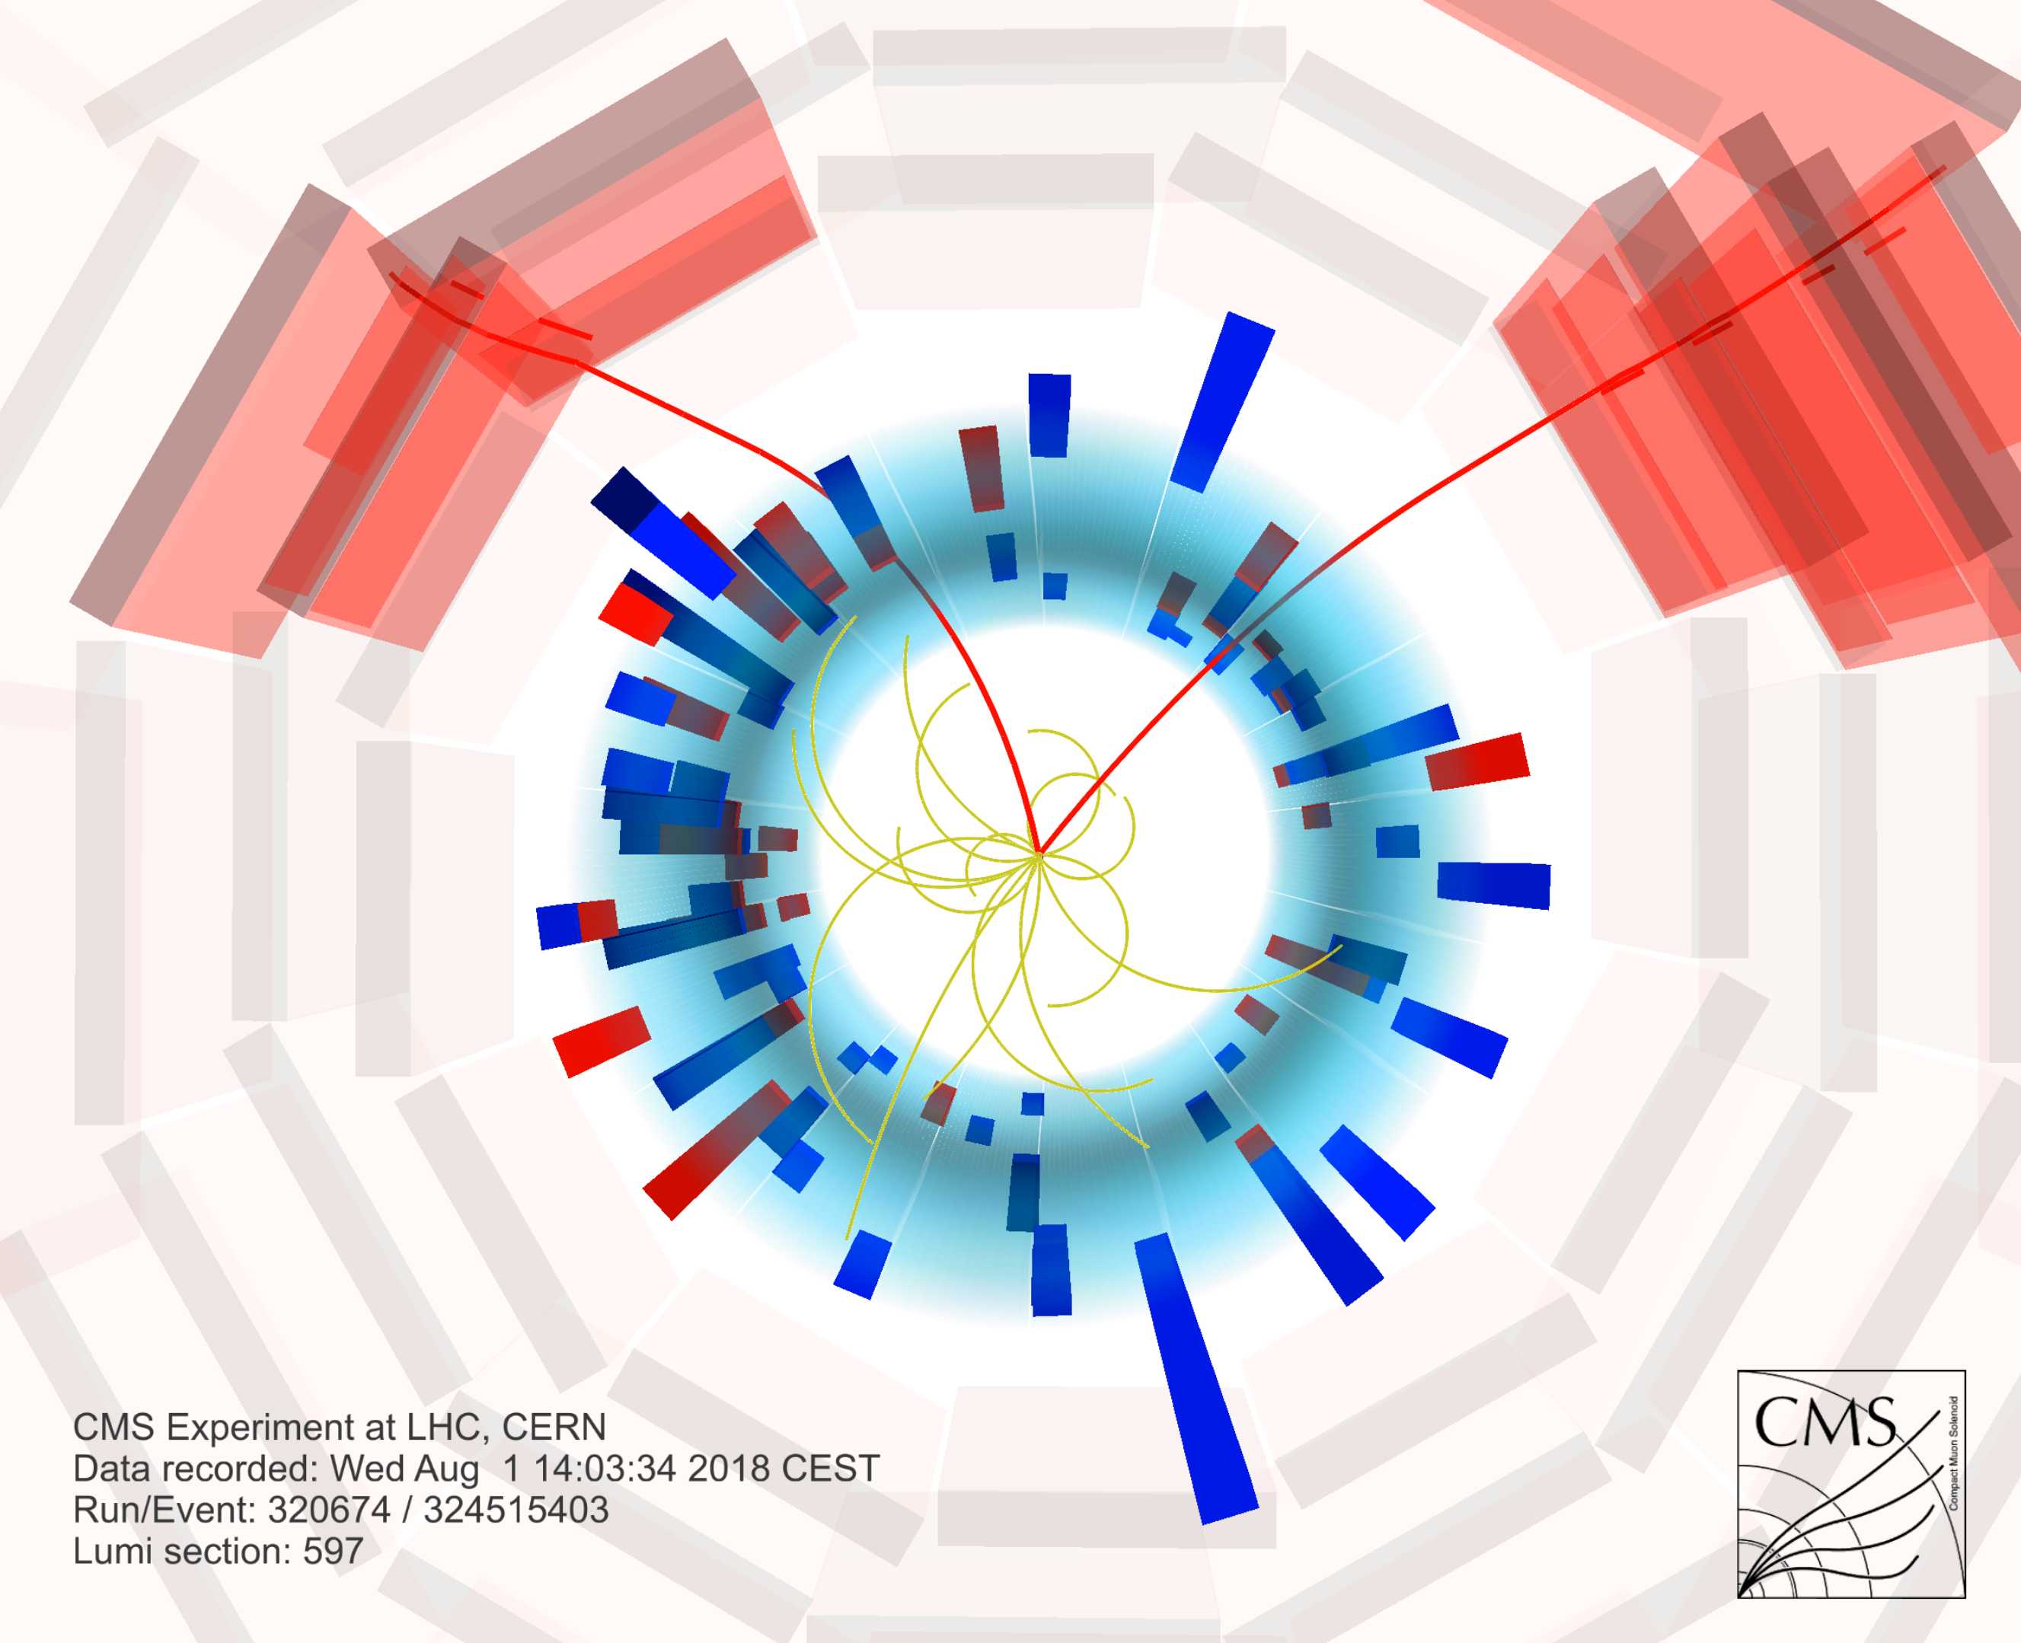
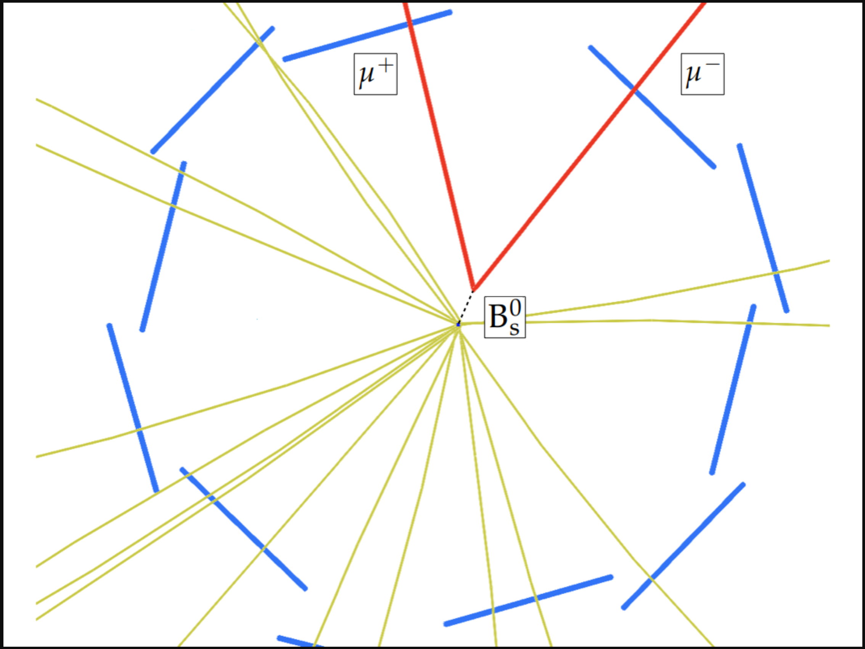
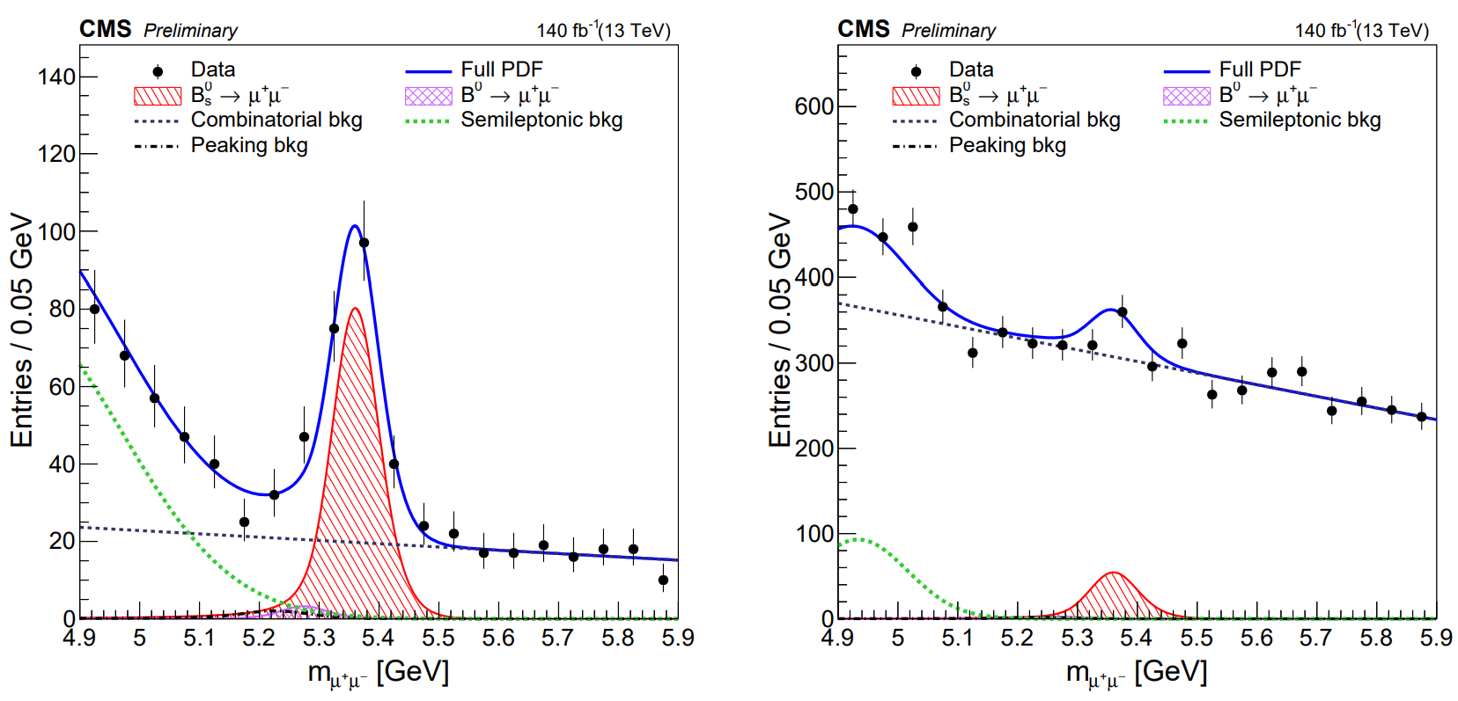
Results
2D fit to mass and per-event mass uncertainty in 16 categories
Signal shape fixed to MC
SL and peak. bkg shapes fixed to MC; yields constrained using MC predictions
Comb.bkg. - polynomial
MVA>0.99
0.9<MVA<0.99
B⁰_{s} 12.5σ
B⁰ 0.5σ
Merged (2016-2018, both |η_{μ}| intervals) projections of the fit and data in 2 MVA ranges

Slide 11
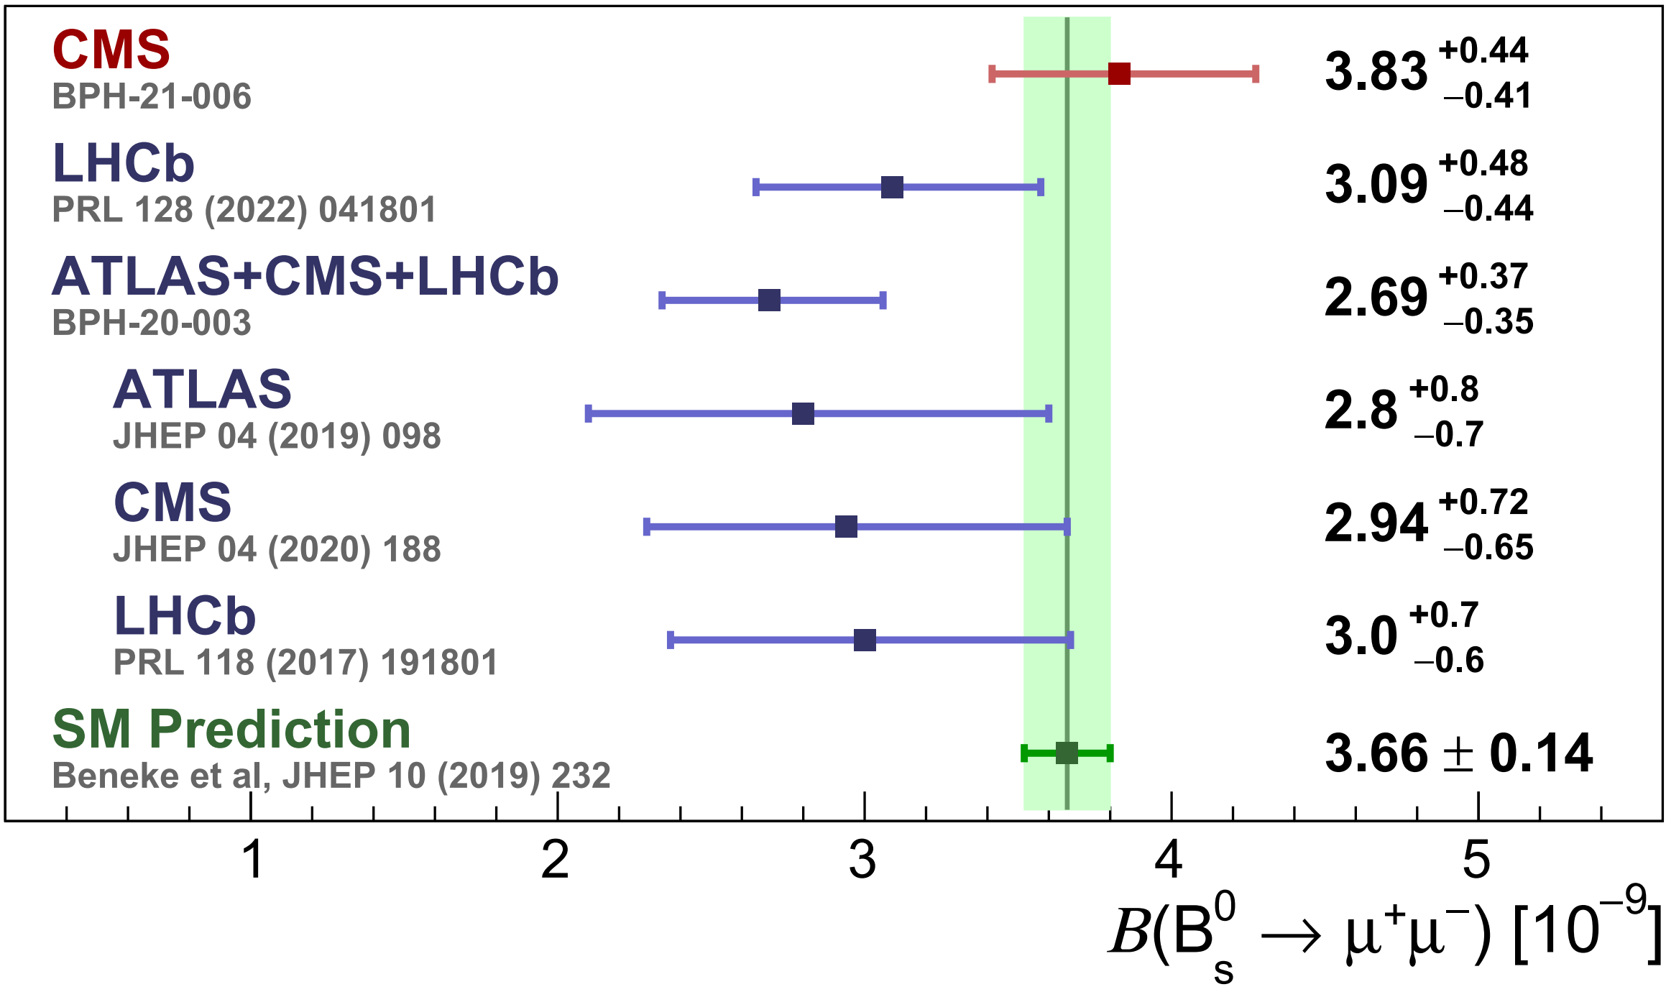
Results for B(B⁰_{s} → μ⁺μ⁻)
The most precise measurement to date!
Excellent consistency with the SM!

Slide 12
Results (simplified version)
B⁰_{s} → μ⁺μ⁻
CMS
B⁰ → μ⁺μ⁻
background

Slide 13
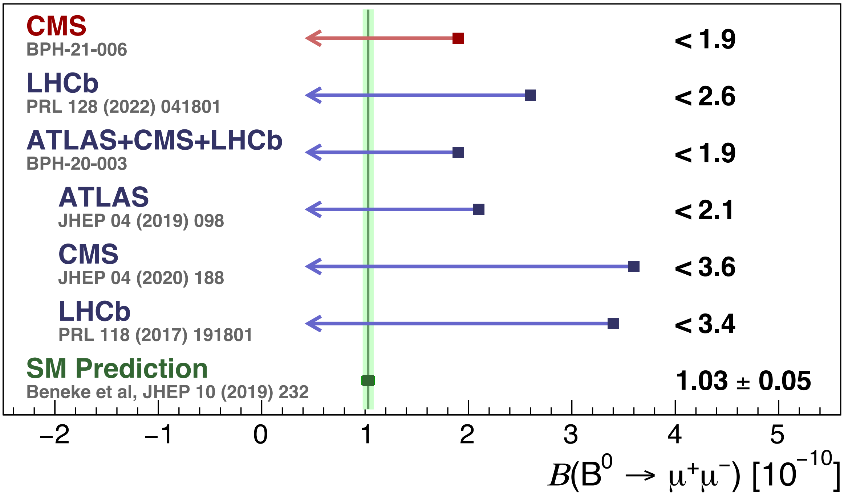
Results for B(B⁰ → μ⁺μ⁻)
The most stringent single-experiment upper limit!

Slide 14
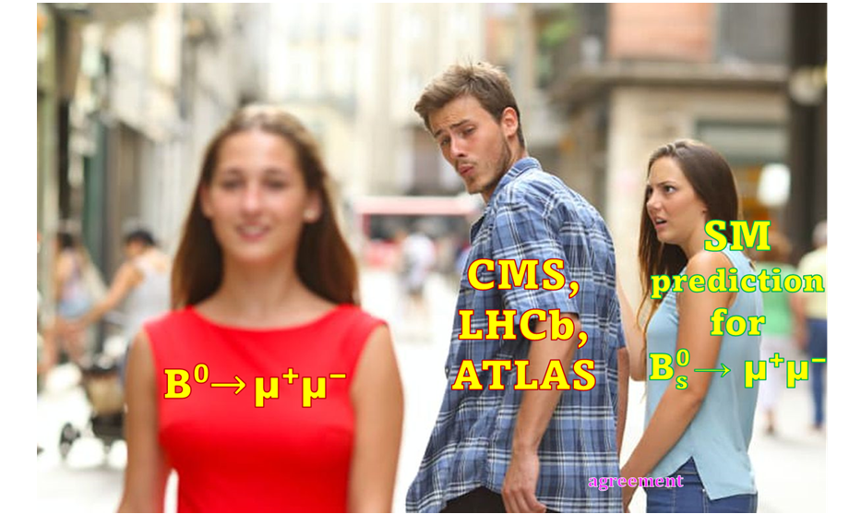
Summary
A new measurement of B → μμ decays is performed by CMS
The result has world-leading precision and agrees with the SM
Measurement of B⁰_{s} → μ⁺μ⁻ effective lifetime is also reported (see backup)
Now waiting for result to perform a full LHC Run-2 combination!
Run-3 will bring additional sensitivity with improved triggers!
Most likely we need to wait until Run-4 to observe B⁰→μ⁺μ⁻
Read more: CMS-BPH-21-006
cms.cern/news/new-study-rare-b-meson-decays-two-muons
https://cds.cern.ch/record/2815334/files/BPH-21-006-pas.pdf
Thank you !

Slide 15
BACKUP

Slide 16
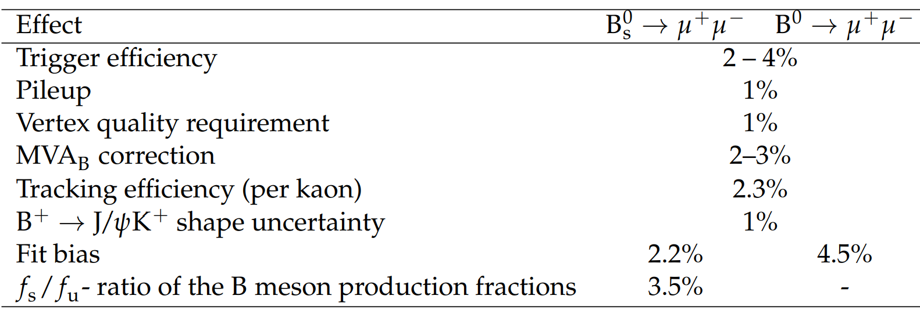
Systematic uncertainties

Slide 17
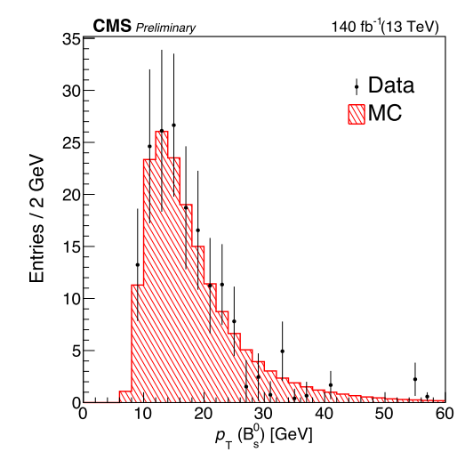
f_{s}/f_{u}

Slide 18
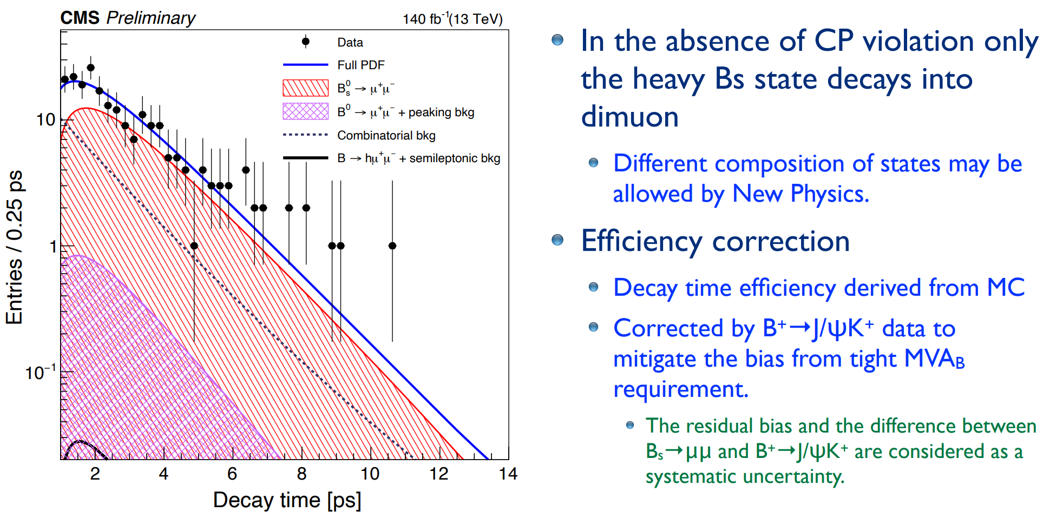
Effective lifetime measurement
Systematics:

Slide 19
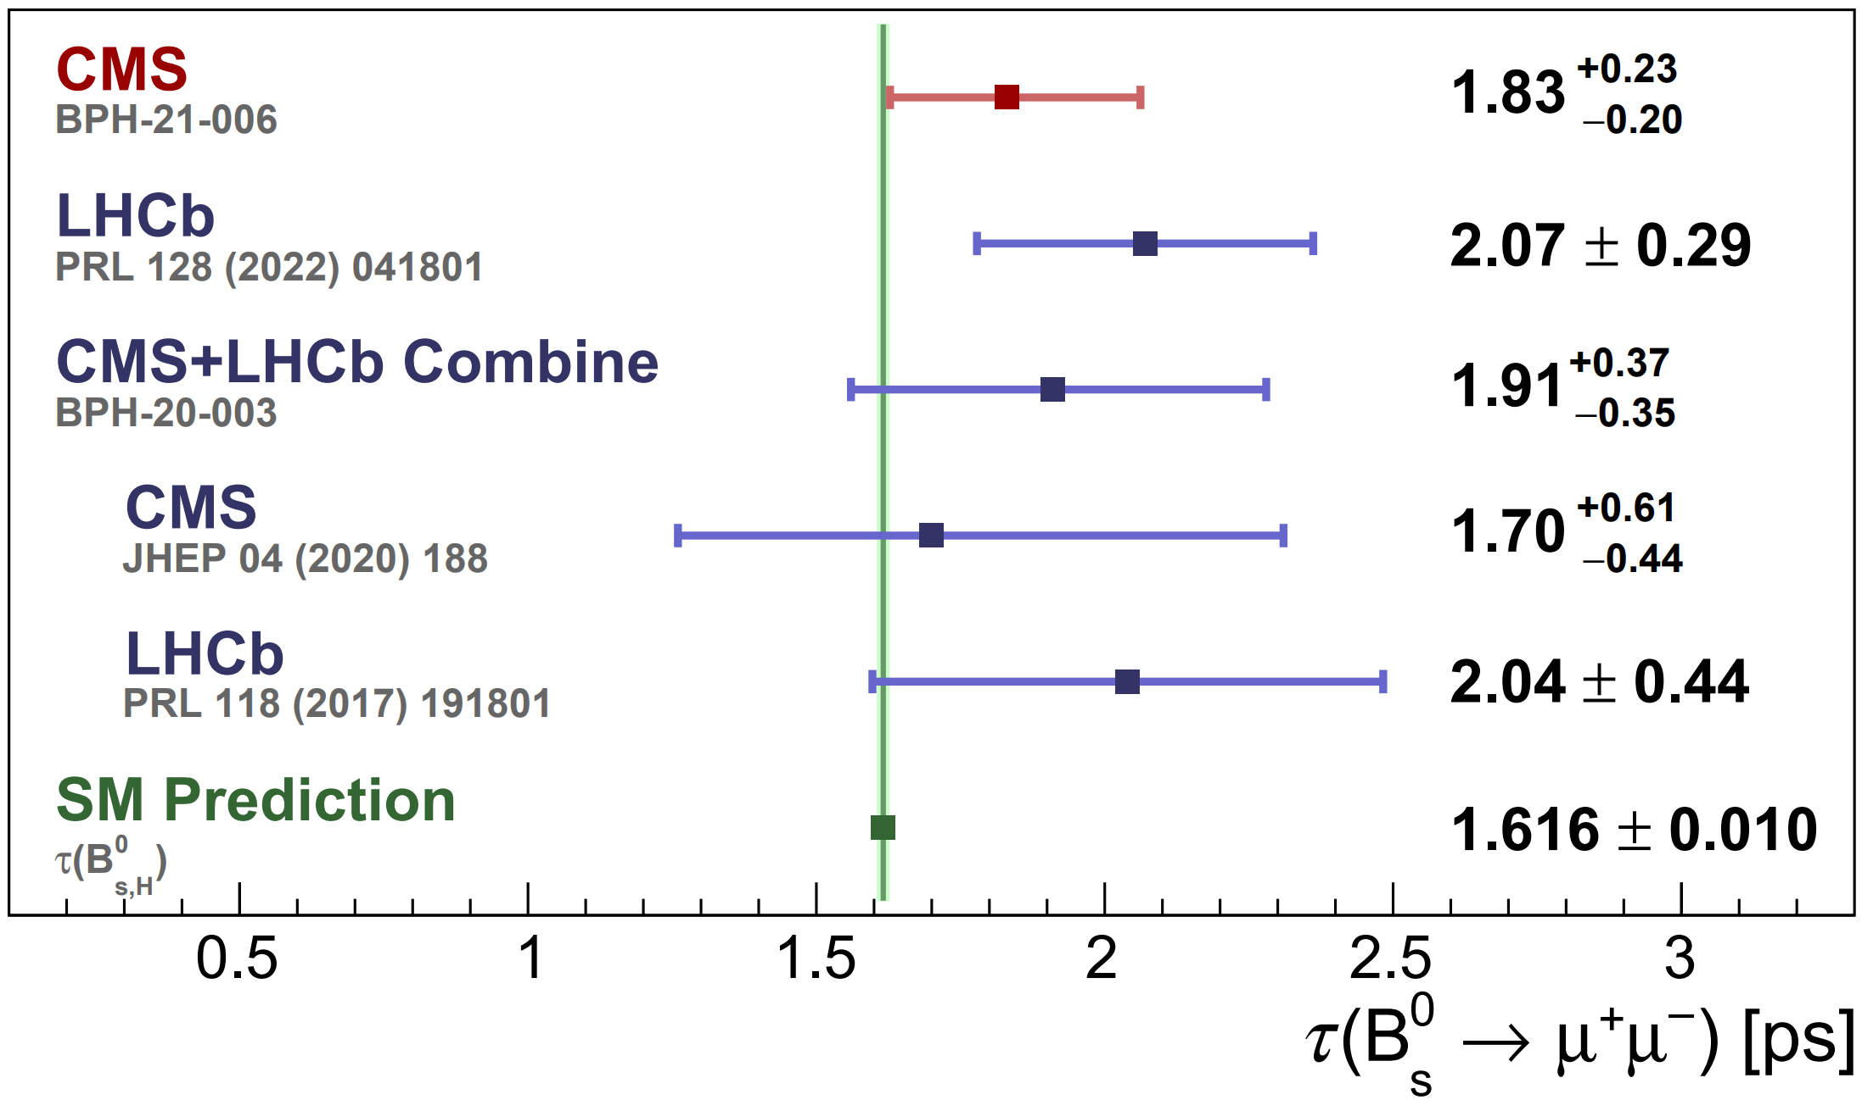
Results for effective lifetime
The most precise measurement! In agreement with SM

Slide 20
b→sll as New Physics probes
b→sll transitions are precisely predicted by Standard Model
Processes are rare (loop level, CKM-suppressed)
→ new interactions can be major contribution
New interactions can have different symmetries from the SM
NP can modify parameters of angular distributions observed in multibody decays B→h l⁺ l⁻

Slide 21
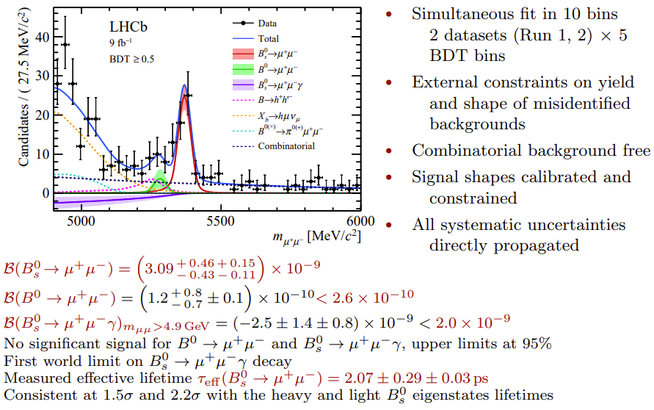
B→μμ LHCb

Slide 22
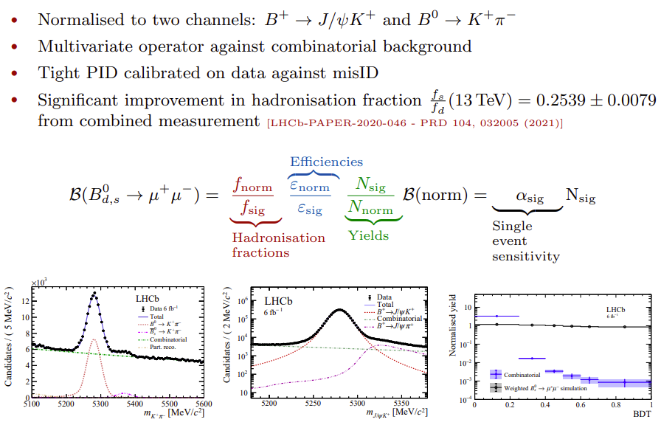
B→μμ LHCb

Slide 23
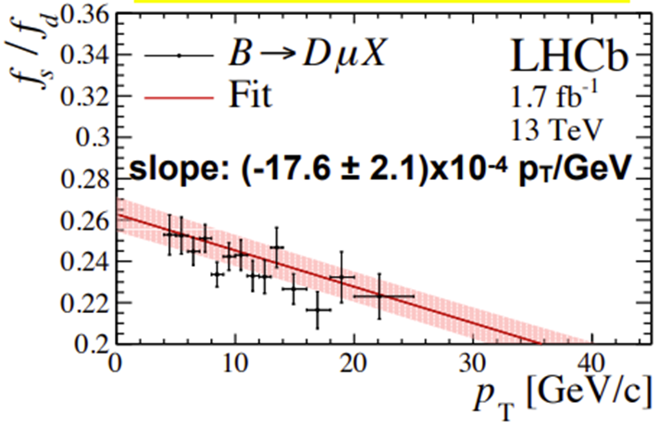
On f_{s}/f_{u} and normalization
LHCb, CMS, ATLAS normalize B⁰_{s} using the B⁺ → J/ψ K⁺ decay;
LHCb in addition uses B⁰→ K⁺π⁻, with low relative weight
This makes f_{s}/f_{u}, ratio of B⁰_{s} and B⁺ production, a crucial ingredient
The current 13 TeV LHCb best value is 0.254 ± 0.008 [assuming f_{u}=f_{d}]
In CMS, the uncertainty is increased to cover √s and kinematic region dependence
Previous CMS result uses 0.015 additional uncertainty, arriving at f_{s}/f_{u} = 0.252 ± 0.019
This 8% of additional uncertainty is one of the leading uncertainties
LHCb-PAPER-2020-046, Phys.Rev.D.104(2021)032005

Slide 24
On f_{s}/f_{u} and normalization
Other possibility is to normalize using the B⁰_{s} → J/ψ φ decay
Current PDG uncertainty is dominated by LHCb measurement, which is done via B⁺ → J/ψ K⁺ and f_{s}/f_{u}, i.e., completely correlated with f_{s}/f_{u}
Belle measurement of B(B⁰_{s} → J/ψ φ) has ~20% uncertainty
No B⁰_{s} decay is measured with a precision of better than 10%
Often, the B is normalized using f_{s}/f_{d} or f_{s}/f_{u}
The “desired” solution to get out of this vicious circle would be Belle II running on Y(5S) resonance and precisely measuring absolute B⁰_{s} branching fractions ☺
With Run-3 data, this normalization channel issue will probably be the leading uncertainty in B(B⁰_{s} →μμ) for CMS & ATLAS

Slide 25
B→ee, B→ττ
Similar, from theoretical point of view, rare decays, predicted B are lower (higher) for e (τ) than for μ:
However, significantly more challenging experimentally
Electrons produce bremsstrahlung radiation in magnetic field, resulting in reduced precision (wide peak)
Taus quickly decay with 1 or two missing neutrinos per one τ lepton, many decay modes, large backgrounds, very broad peak in m(ττ)
With LFU, different NP effects can affect ee, μμ, and ττ modes differently → important to search/study all 3 decay modes!

Slide 26
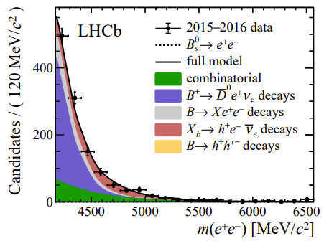
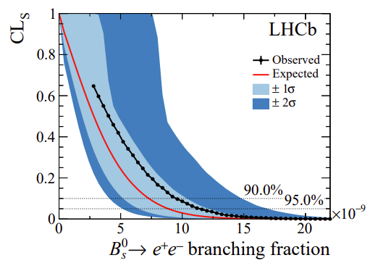
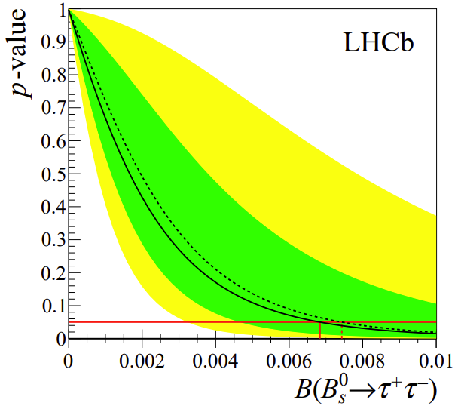
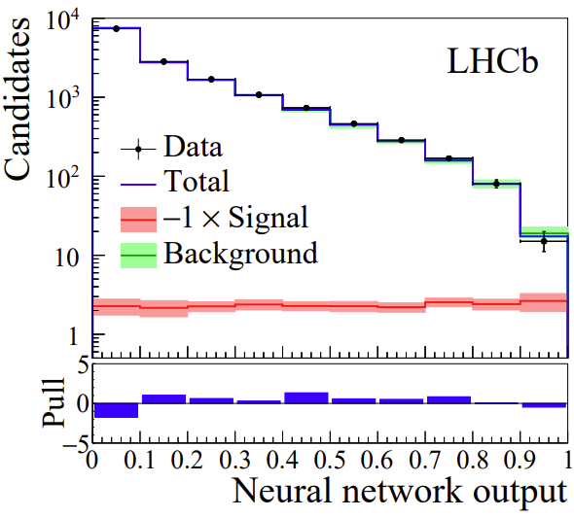
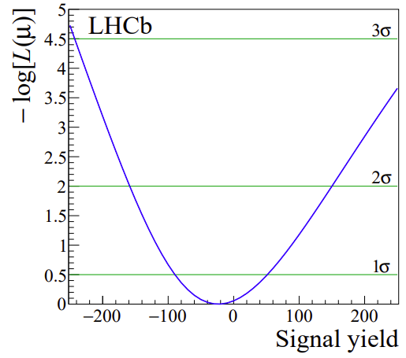
B→ee, B→ττ
LHCb has performed searches for ee and ττ decays
ee: Run-1+2015+2016
CL
normalized to B⁺ → J/ψ(ee) K⁺
ττ: Run-1 analysis, normalized to B → DD_{s}
CL
LHCb-PAPER-2020-001, Phys.Rev.Lett.124(2020)211802
LHCb-PAPER-2017-003, Phys.Rev.Lett.118(2017)251802
Upper limits many orders of
magnitude larger than SM predictions

Slide 27
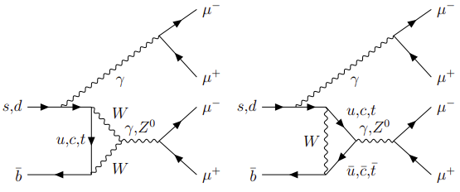
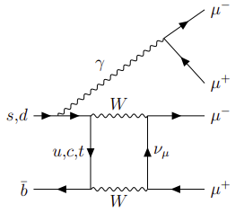
B→ μμμμ
If no intermediate resonance, FCNC transitions:
Very rare in SM:
Some SM extensions involve intermediate scalar
B→aa→4μ with m(a)~1GeV

Slide 28
Tensions in b→sll transitions

Slide 29
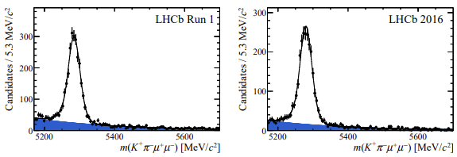
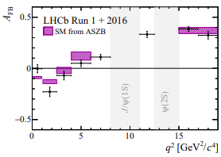
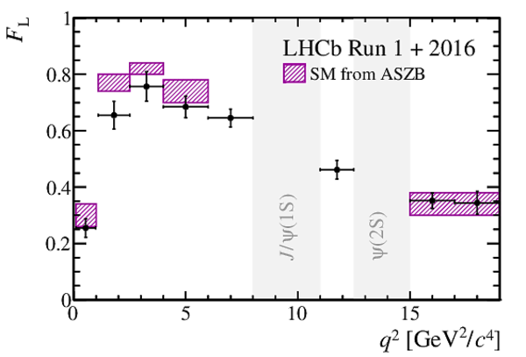
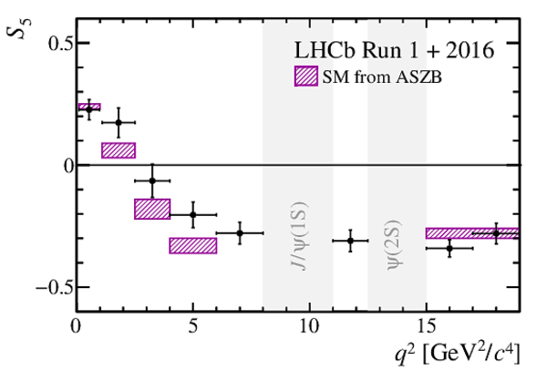
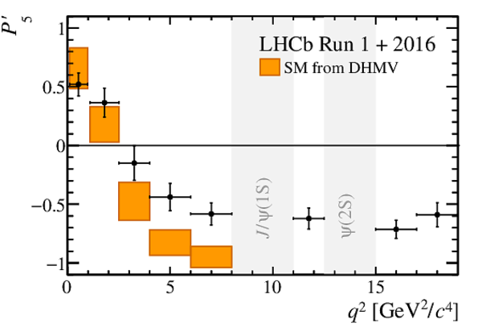
Angular analyses of b→sll transitions
Many recent results measuring angular parameters and differential branching fractions
B⁰→K^{*0}μ⁺μ⁻, Run-1+2016, ~4500 signal
LHCb-PAPER-2020-002, Phys.Rev.Lett.125(2020)011802
ATLAS and CMS Run-1 results in backup
~3σ tension at low q² !
CMS Run-2 analysis in development

Slide 30
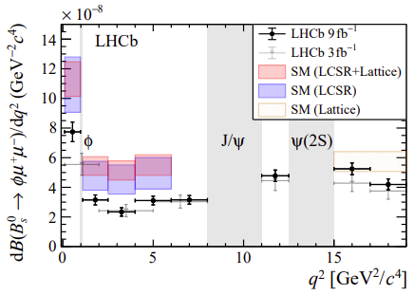
Angular analyses of b→sll transitions
BF measurement of B⁰_{s} →φμ⁺μ⁻ and B⁰_{s} →f₂’(1525)μ⁺μ⁻
LHCb Run-1 + Run-2
LHCb-PAPER-2021-014, Phys.Rev.Lett.127(2021)151801
~3.6σ tension w.r.t. SM at low q²
More details in the parallel talk by Samar N. yesterday
First observation!
BF compatible with SM

Slide 31
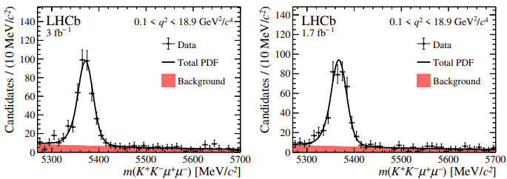
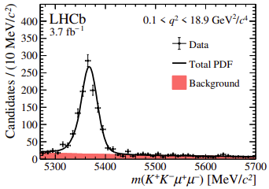
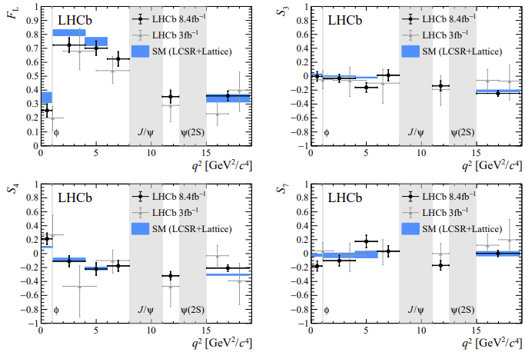
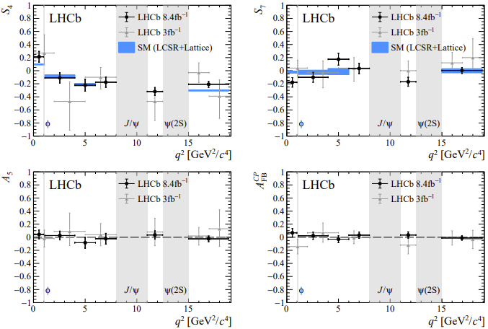
Angular analyses of b→sll transitions
More details in the parallel talk by Samar N. yesterday
B⁰_{s} →φμ⁺μ⁻ angular, Run-1+Run-2 (no 2015), ~2000 signal
2011-2012
2016
2017-2018
Compatible with SM
CMS Run-2 analysis in development
LHCb-PAPER-2021-022, JHEP11(2021)043

Slide 32
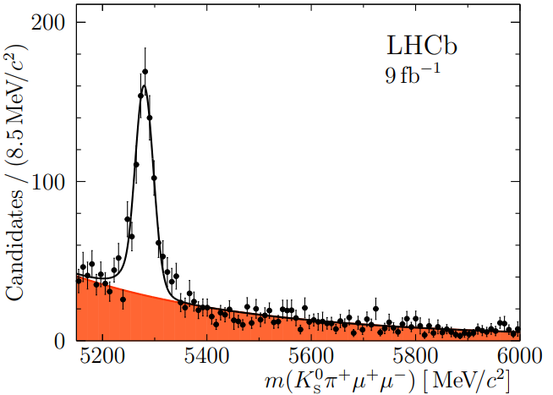
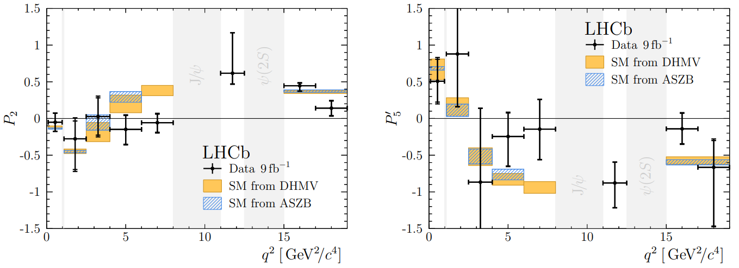
Angular analyses of b→sll transitions
B⁺→K^{*+}μ⁺μ⁻, (K^{*+}→K⁰_{S} π⁺) LHCb Run-1 + Run-2, ~90 signal
Lower statistics compared to K^{*0} channel because of K⁰_{S}
Two categories based on K⁰_{S} decay vertex position
Angular analysis, measuring full set of optimized variables,
F_{L} ,S₃ ,S₄, S₅, A_{FB}, S₇, S₈, S₉, P₁, P₂, P₃, P’₄, P’₅, P’₆, P’₈
in 5 folds of the data, due to limited stat.
B⁺→K^{*+}μ⁺μ⁻
737±34
3.1σ tension w.r.t SM at low q² !
More details in the parallel talk by Samar N. yesterday
LHCb-PAPER-2020-041, Phys.Rev.Lett.126(2021)161802

Slide 33
P5’ HL-LHC

Slide 34
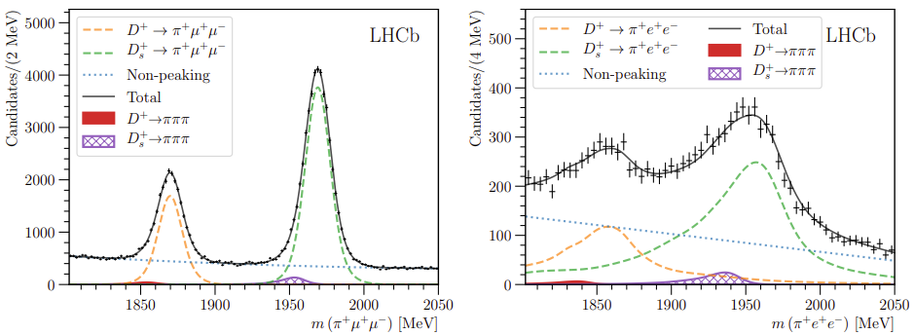
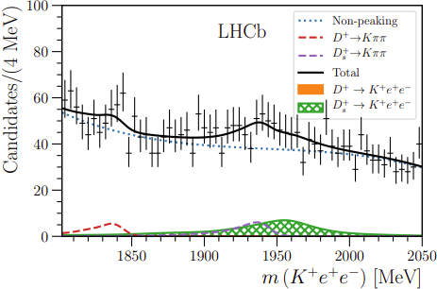
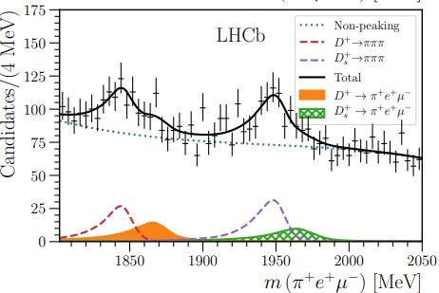
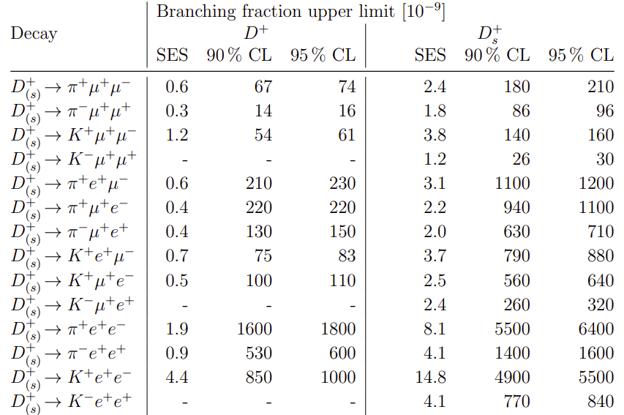
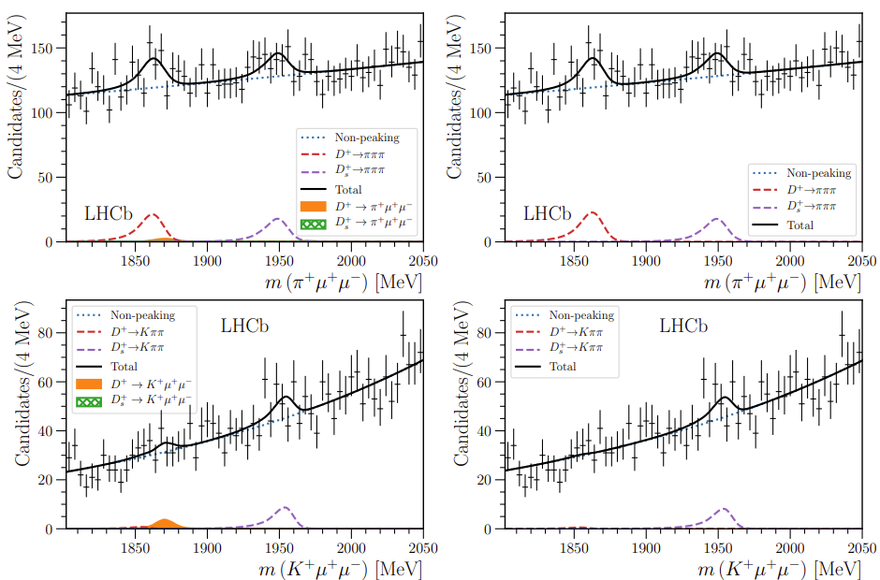
Rare charm decays
LHCb JHEP 06 (2021) 044

Slide 35
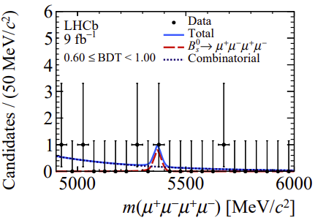
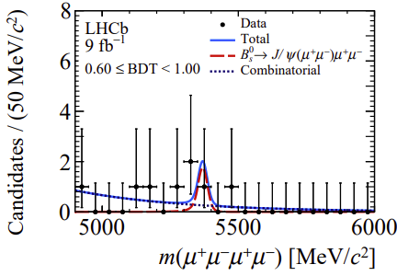
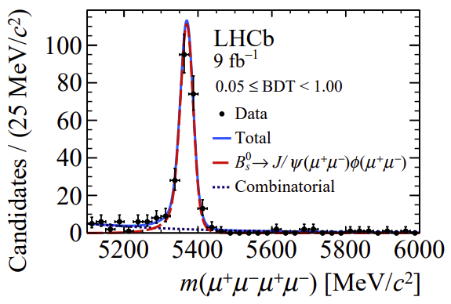
B→ μμμμ
Recent LHCb search uses Full Run1+Run-2 data
Using B⁰_{s} →J/ψφ →4μ for the normalization
Search also performed for B⁰_{(s)}→J/ψμμ decays
LHCb-PAPER-2021-039, JHEP03(2022)109
Upper limits (with excluded known resonance regions) are most stringent to date
m(a)=1GeV, promptly decays
More details in the parallel talk by Christina A. yesterday

Slide 36
B⁰→ φ μμ
LHCb-PAPER-2021-042, JHEP05(2022)067
B⁰_{s}
SL
Signal
B⁰ →K*μμ
Part.
reco
Λ_{b}→pKμμ
More details in the parallel talk by Christina A. yesterday

Slide 37
K⁰_{S} → μμ
FCNC process, in SM
Some NP (SUSY/LQ) models modify the B
LHCb performed a search using Run-2 data
Normalization using decay to π⁺π⁻
This decay is also the main background
LHCb-PAPER-2019-038, Phys.Rev.Lett.125(2020)231801
Statistically combined with Run-1 result upper limit is most stringent to date:

Slide 38
LFV searches
Lepton Flavor is conserved in SM to a very good precision
Observation of LFV process at a rate above SM prediction would immediately point to New Physics contribution

Slide 39
τ → μμμ
At LHC, two main channels for this search (depending on τ leptons’ source):
• Heavy Flavor: abundant (especially from D_{s}⁺) but challenging because of very low p_{T}, forward muons
• W → τν: ~10⁴ time less yield, but very clear signature
LHCb-PAPER-2014-052, JHEP02(2015)121
ATLAS-EXOT-2014-14, Eur.Phys.J.C76(2016)5,232
CMS-BPH-17-004, JHEP01(2021)163
CMS Run-2 analysis in development

Slide 40
B⁺→ K⁺μ⁻τ⁺
LHCb Full Run 1 + Run 2 analysis
Using B*_{s2} → B⁺K⁻ decays to tag partially-reconstructed B⁺ mesons
Normalization using B⁺→ K⁺μ⁻μ⁺ (with J/ψ)
LHCb-PAPER-2019-043, JHEP06(2020)129
Weaker than 2012 BaBar upper limit
More details in the parallel talk by Liang S. yesterday

Slide 41
B⁺→ K⁺μ∓e±
LHCb Run-1 analysis
Normalization using B⁺→ K⁺μ⁻μ⁺ (with J/ψ)
LHCb-PAPER-2019-022, Phys.Rev.Lett.123(2019)241802
World-best limits
More details in the parallel talk by Liang S. yesterday
Run-2 analysis ongoing

Slide 42
B⁰→ K^{*0}μ∓e± and B⁰_{s}→ φμ∓e±
LHCP-PAPER-2022-008, in preparation. Full Run-1 + Run-2 analysis
Normalization using B⁰→J/ψK^{*0} and B⁰_{s}→ J/ψφ
World-best limits
More details in the parallel talk by Liang S. yesterday

Slide 43
ATLAS experiment

Slide 44
LHCb

