Slide 1
Beam feedback and IP feedback for STCF
Joint Workshop on Future Charm-tau Factory
Zeran Zhou
NSRL USTC 2019 09 26

Slide 2
01 Motivation
目
02 Beam feedback Developing
Contents
录
03 IP feedback study
04 Summary

Slide 3
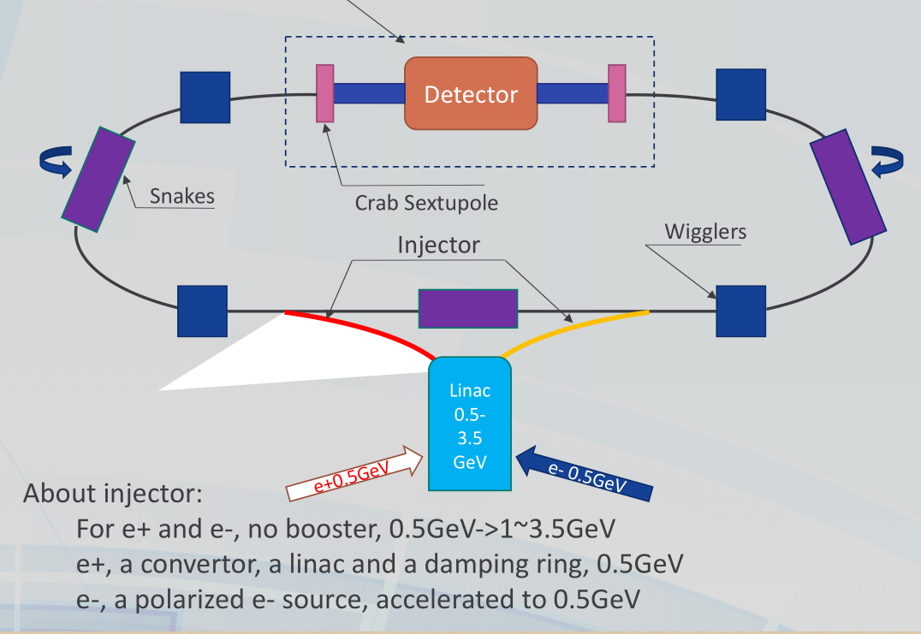
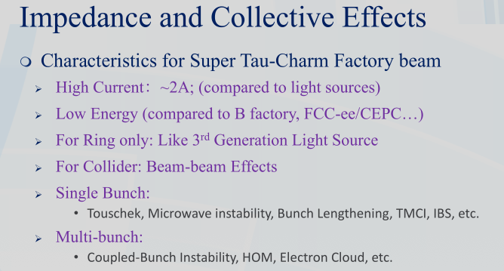
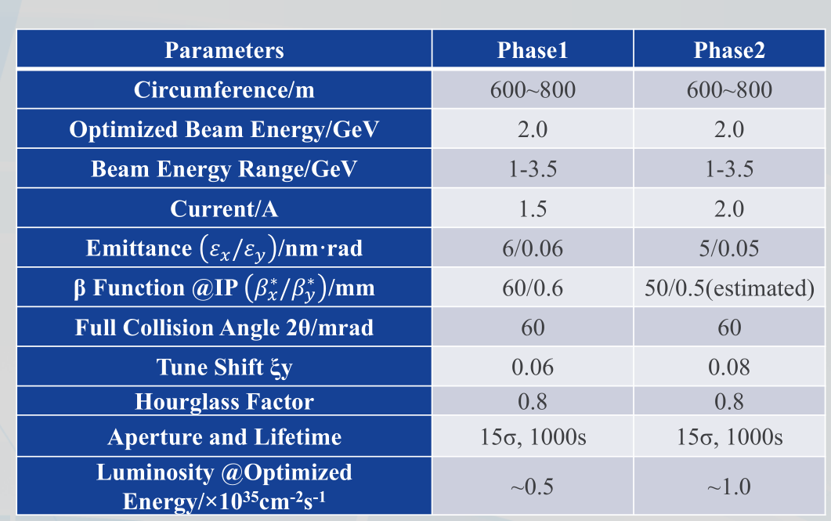
Motivation
Multi-bunch collective phenomena are a big limitation to high current operation in storage rings:
--transverse and longitudinal instabilities
--beam quality deterioration
--beam loss
high beam currents have been possible only by using powerful beam feedback systems(electron ring, positron ring, damping ring)
Notes:
Positron electron

Slide 4
Two feedback systems are needed
Beam Feedback system should handle:
  horizontal and vertical planes, also longitudinal plane;
  various unstable modes coming from unknown sources:
    Resistive wall
    Photo electron instability
    Fast ion instability
    Injection kicker induced oscillation
IP Feedback system to maximize luminosity
  A luminosity dither system is needed for collision orbit feedback, finding the horizontal offset at the interaction point (IP) that maximizes luminosity.

Slide 5
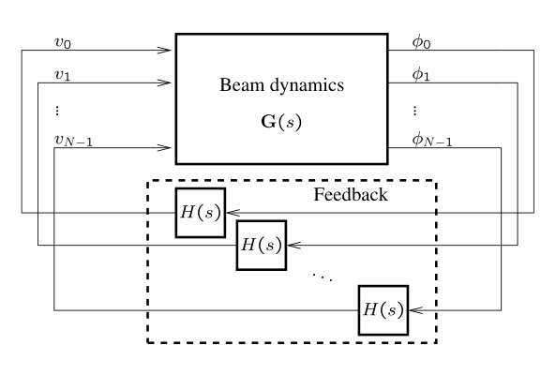
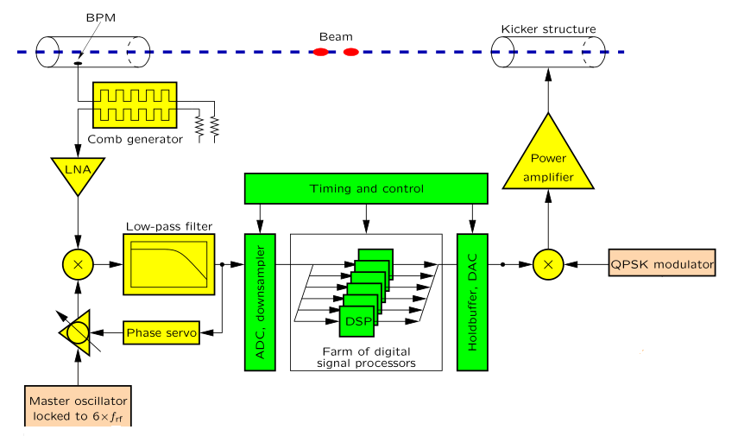
Basic idea of bunch-by-bunch feedback
Coulpled-bunch instabilities are detected using BPMs:
1. Multi-input multi-output (MIMO) system of beam;
2. For N bunches, there are N inputs and outputs.
3. Sequential processing, parallel analysis.
A bunch-by-bunch feedback individually steers each bunch by applying electromagnetic kicks every time the bunch passes through the kicker.
Notes:
phase demodulation; wide band to base band

Slide 6
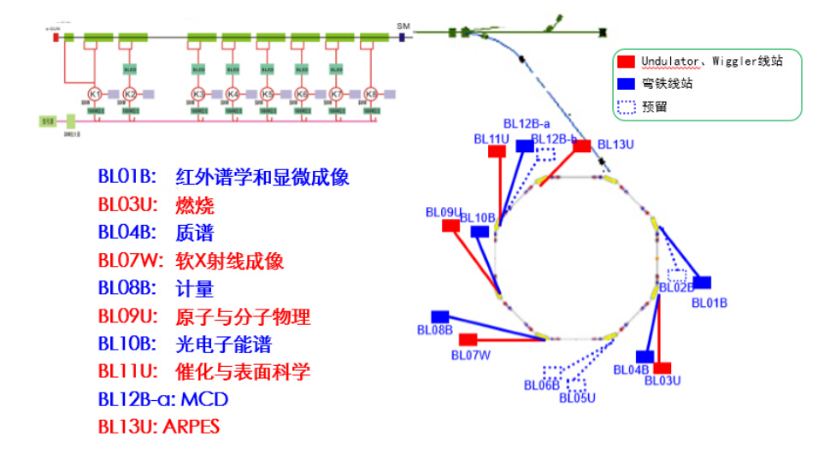
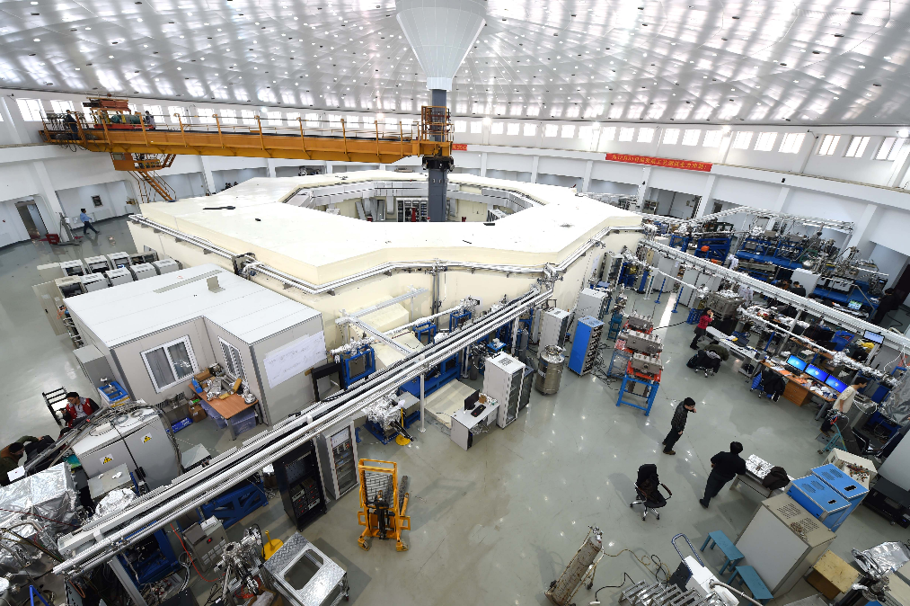
Hefei Light Source(HLSII)
HLSII is 800MeV synchrotron radiation facility with 360mA current, 66m circumference storage ring and an 800 MeV full energy injection linac, which has complete from HLS to HLSII at 2014, top-up operation at 2018.

Slide 7
Timeline of BxB system at HLS
2005~2008 Analog transverse bxb feedback system
2007~2010 Digital transverse bxb feedback system
2014~now Digital transverse and longitudinal feedback

Slide 8
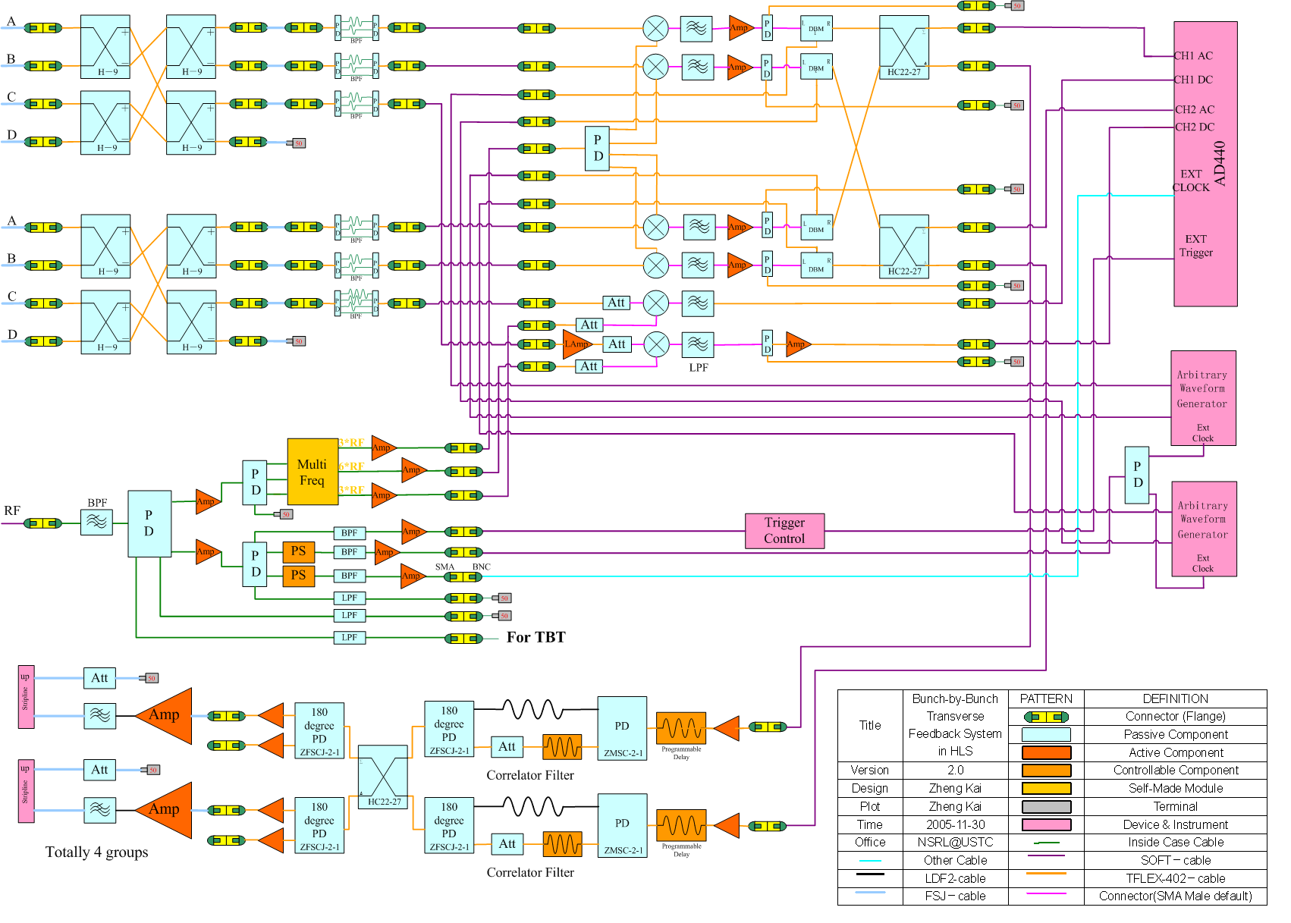
2005~2008 Analog transverse bxb feedback system

Slide 9
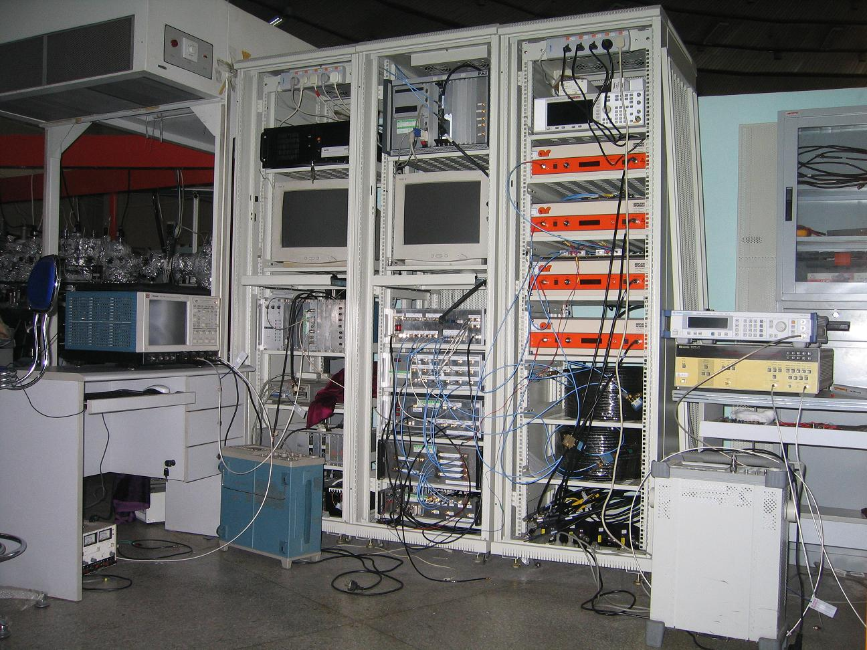
Analog feedback system (photo taken at 2006)

Slide 10
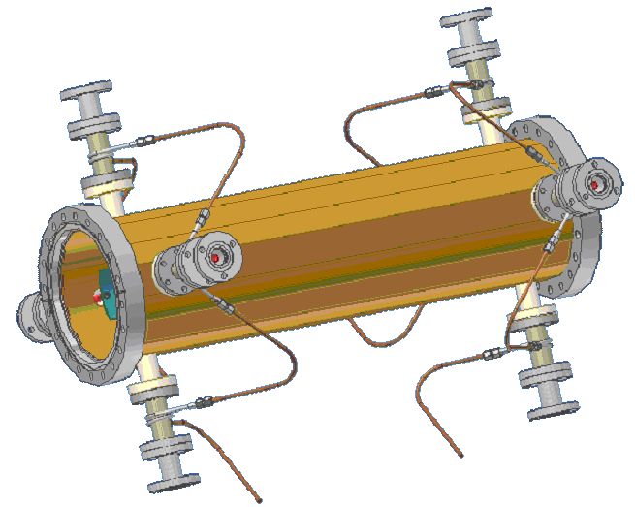
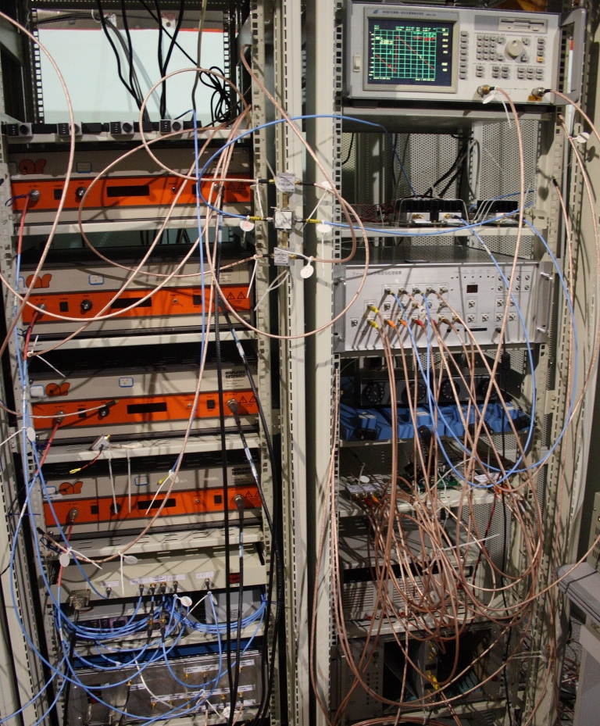
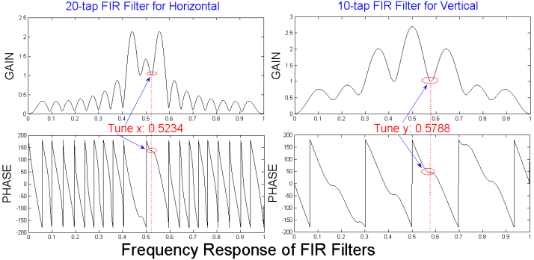
Digital transverse bxb feedback system of HLS(photo taken at 2008)

Slide 11
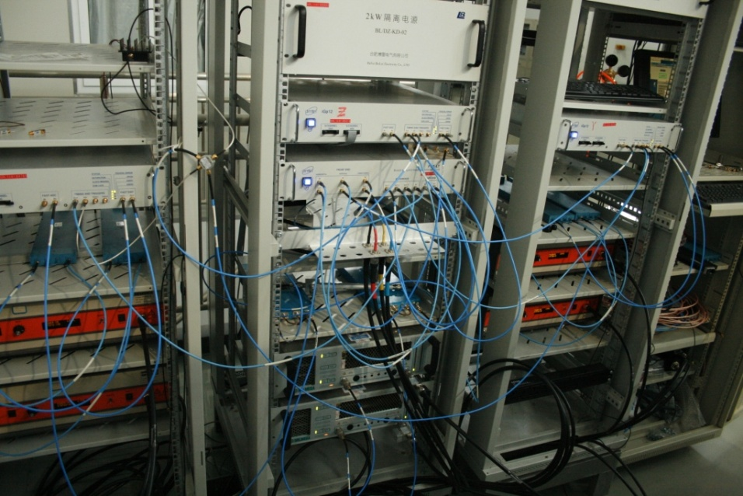
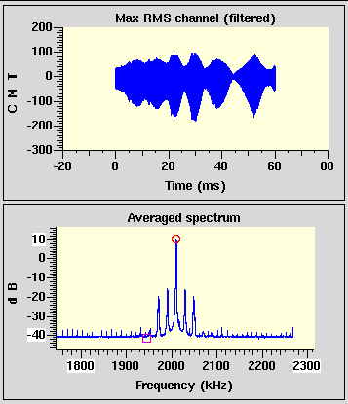
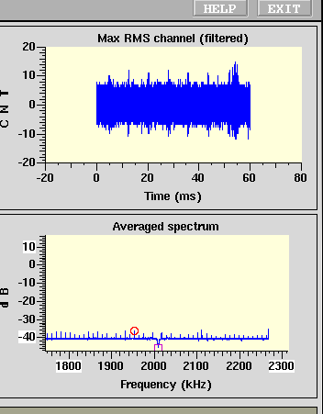
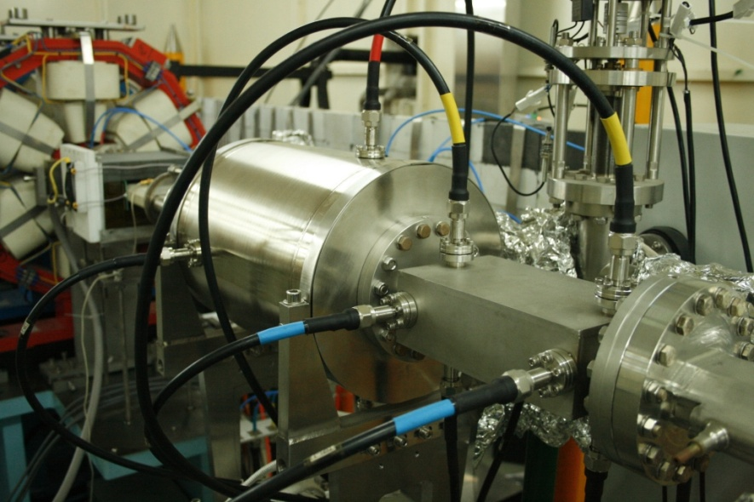
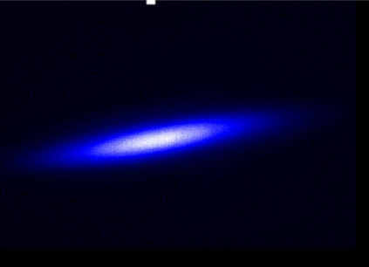
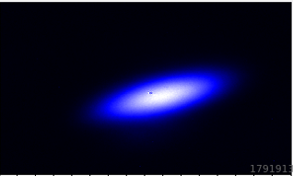
2014~now Digital transverse and longitudinal feedback
The feedback system was upgraded with digital transverse and longitudinal feedback system by 2014, along with HLSII upgrade project.

Slide 12
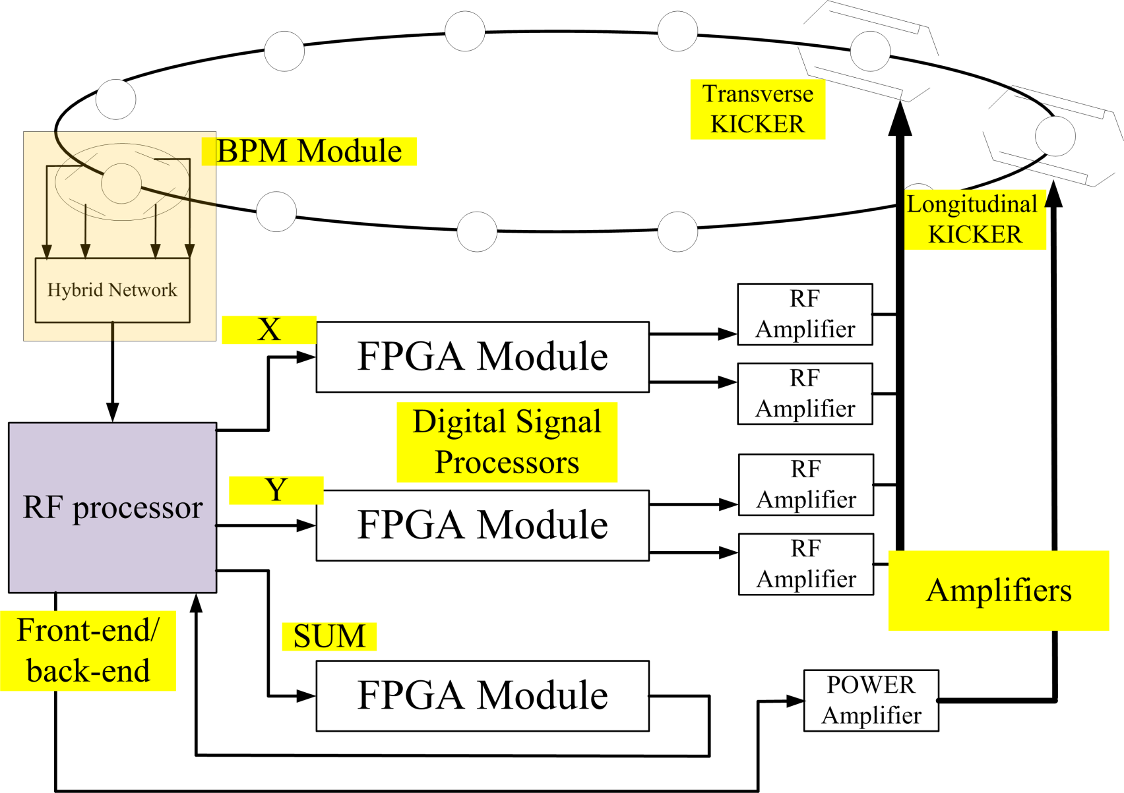
Beam feedback for STCF

Slide 13
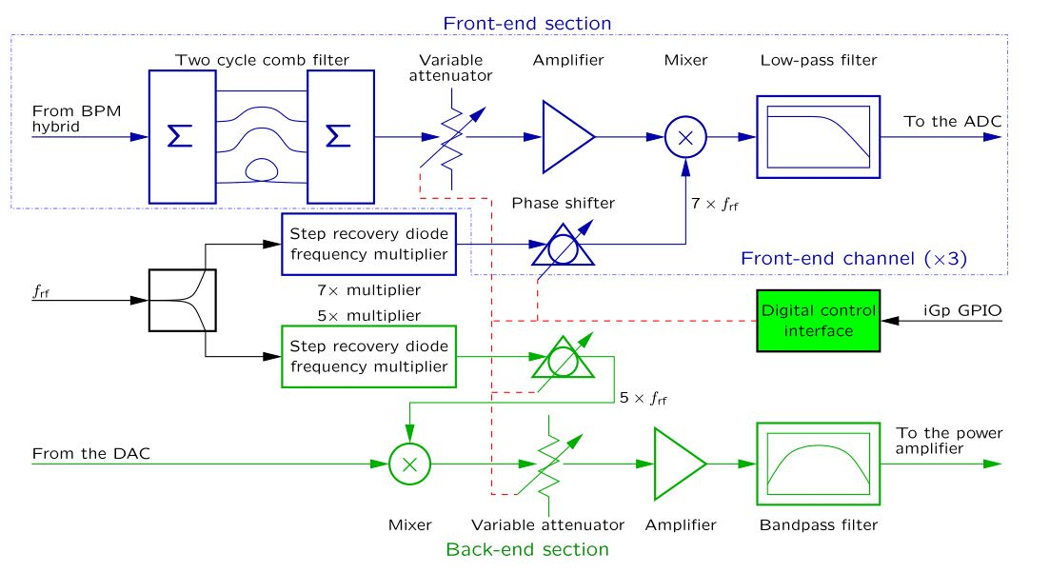
RF Processor
Optimized for 500MHz RF frequency of storage ring (204MHz for HLS)
1. Low amplitude and phase noise;
2. High isolation between neighboring bunches.

Slide 14
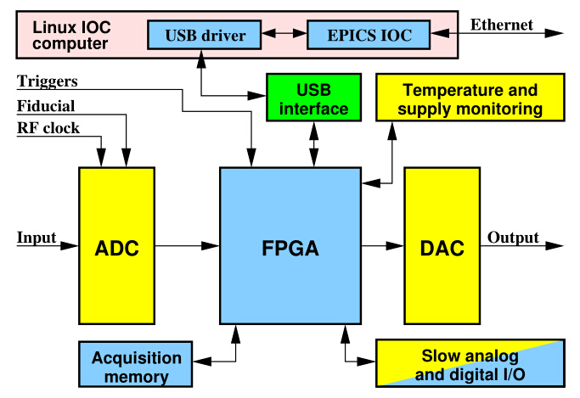
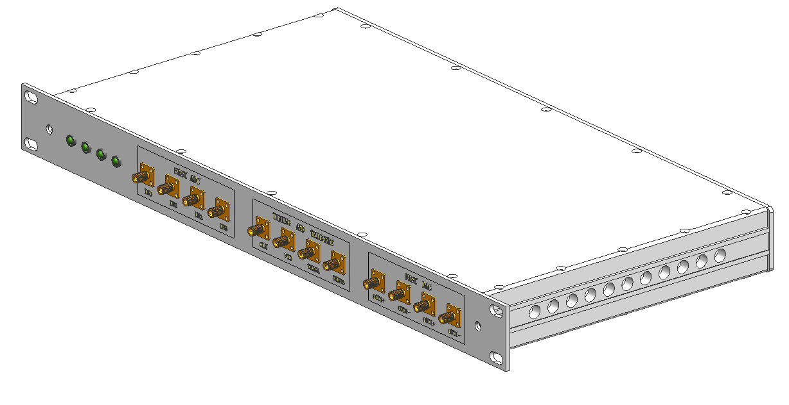
Feedback Processor
Designed for 500MHz RF frequency of storage ring
Similar with iGp structure
Digital board + IOC board
Digital board: 500MHz ADCs 2500MHz DACs, Intel Arria V FPGA, PCIe bus
IOC board：X86 system running linux with EPICS

Slide 15
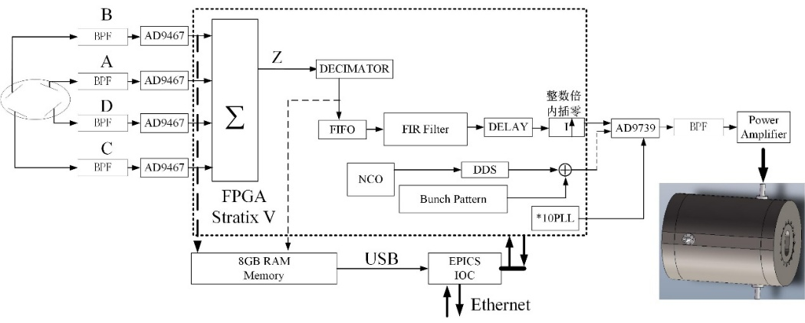
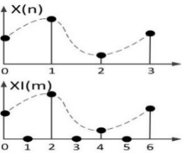
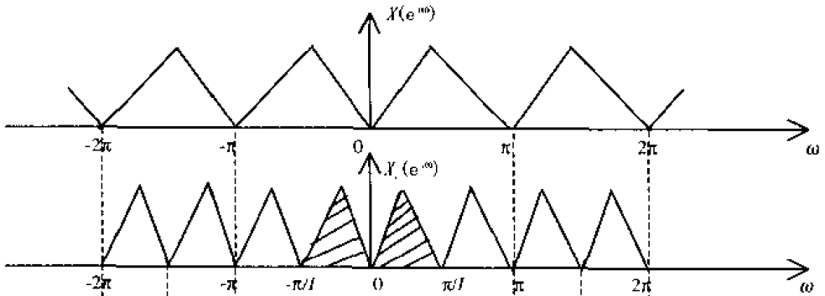
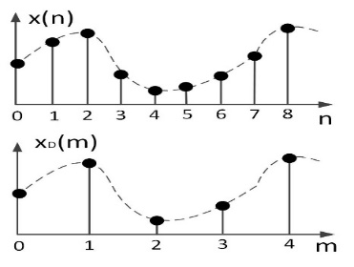
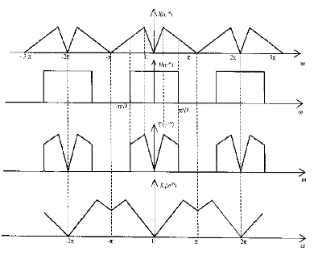
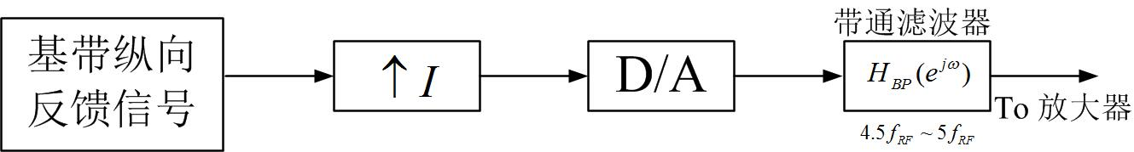
Some techniques for longitudinal feedback processing
DAC Interpolation with zero（Upconvert）
ADC Downsampling
Longitudinal kicker works at RF frequency(~1 GHz), and normally it needs back-end RF components to upconvert base band signal to wide band longitudinal kick signal.
Interpolation with zero of DAC introduces mirror spectrum at higher frequency. With interpolation factor I, the spectrum of DAC output increases I times with mirror spectrums of base band signal. Using band-pass filter to get the desired RF kicks for longitudinal feedback. (Digital upconversion scheme, 2.5GHz DAC is used.)
Revolution frequency is much higher(over 100 times in HLSII) than the synchrotron frequency, downsampling technique makes filter design much easier. After downsampled factor D, the spectrum of target tune expands D times.
For bunch-by-bunch feedback, the feedback kick of N-th bunch using [N，N-D,N-2D，...]turns BPM data, and the feedback signal repeats D turns for individual bunch.

Slide 16
Mode Analysis
Each multi-bunch mode is characterized by a bunch-to-bunch phase shift:
where n is the coupled bunch mode number (n=0,1,…,M-1), M is harmonic number of storage ring.
The phase shift for multi-bunch mode could be seen from the bunch-by-bunch data, for sideband frequencies are located at
Where p is an integer, νs is the tune, f0 is the revolution frequency, m is the bunch oscillation mode number.

Slide 17
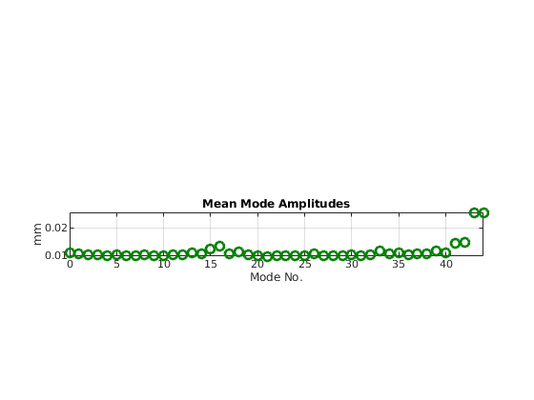
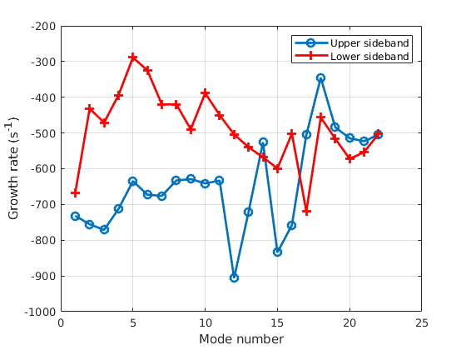
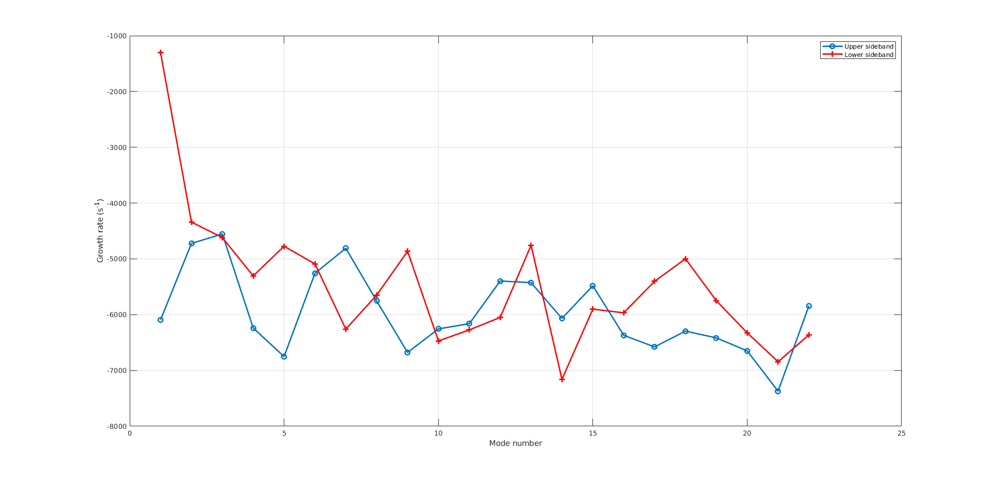
Transverse Mode Analysis of HLSII
Horizontal：
#44 is the dominated mode, resistive wall
Vertical：
No dominated mode

Slide 18
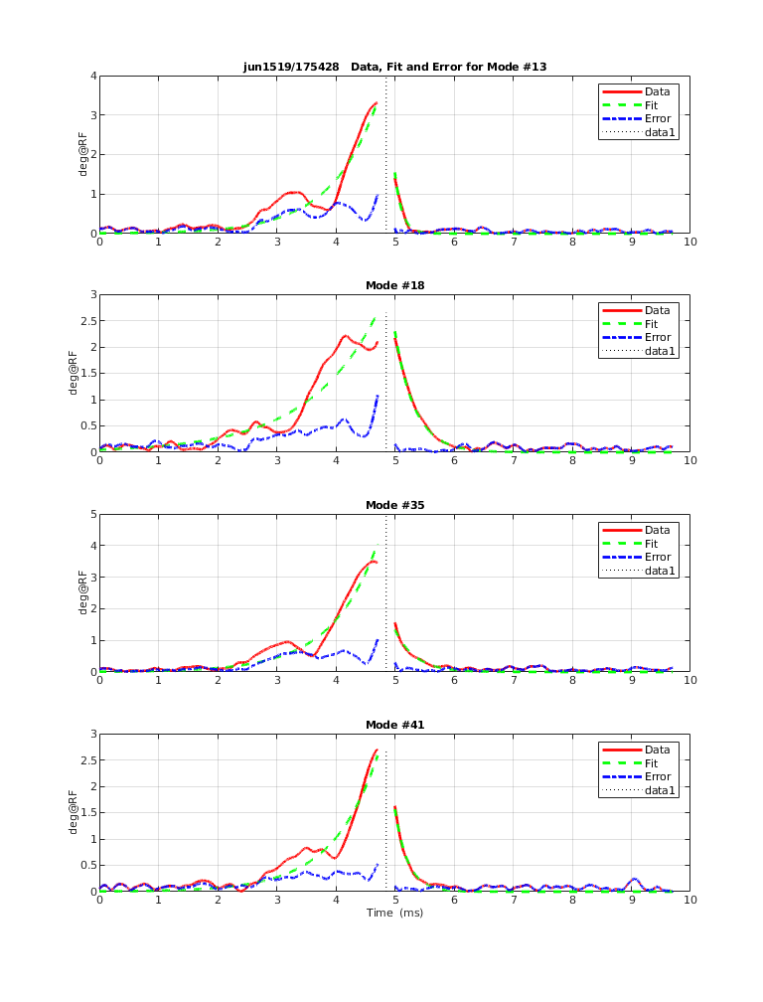
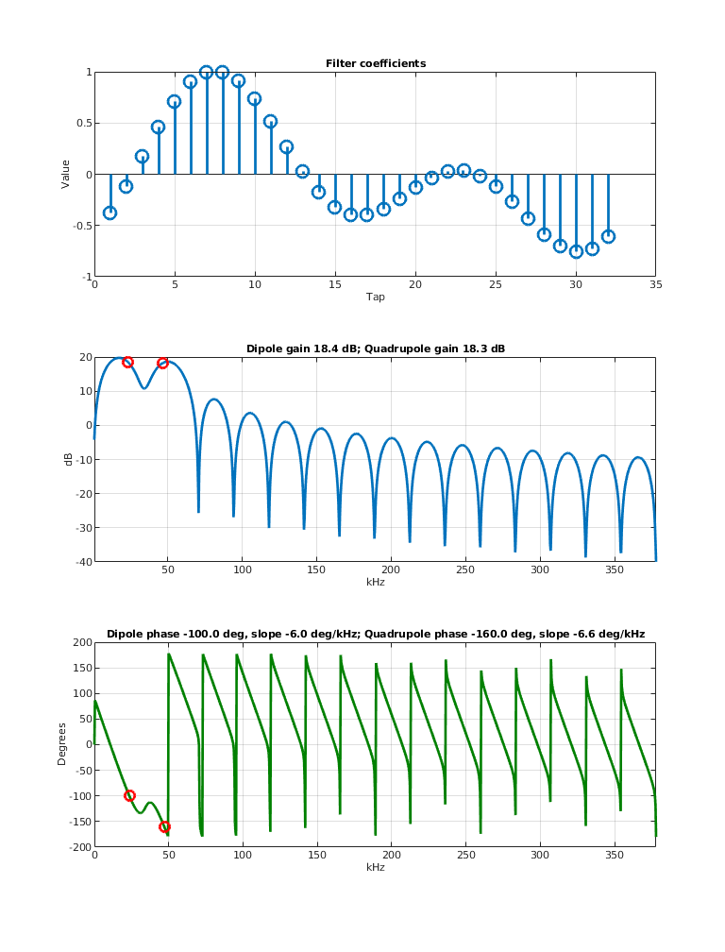
Longitudinal Mode of HLSII
Dominated modes for longitudinal:
1. mode 13(dipole) and mode 18(quadrupole)
2. The digital filter should suppress the dipole and quadrupole oscillations simultaneously

Slide 19
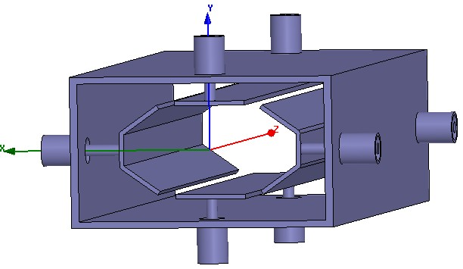
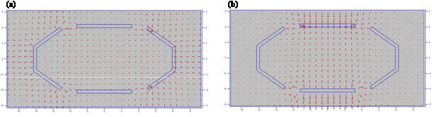
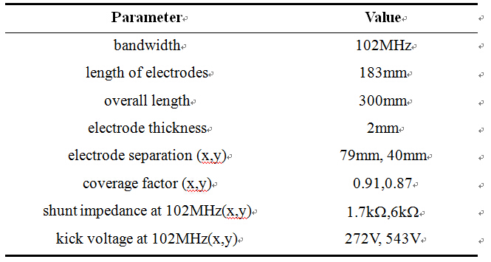
Stripline type transverse kicker
Simulation of 2D electric field distribution by Poisson
Simulation of shunt impedance

Slide 20
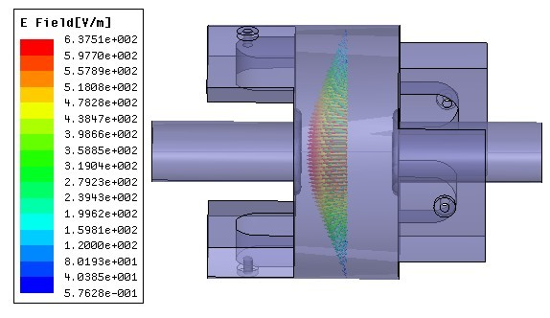
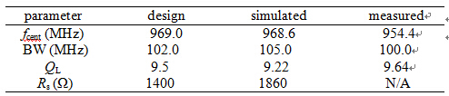
Pill-box type longitudinal kicker
Simulation model using HFSS

Slide 21
S11 parameter measurement for each port of longitudinal kicker
Measured and simulated distribution of the square of the electric field along the central z-axis.

Slide 22
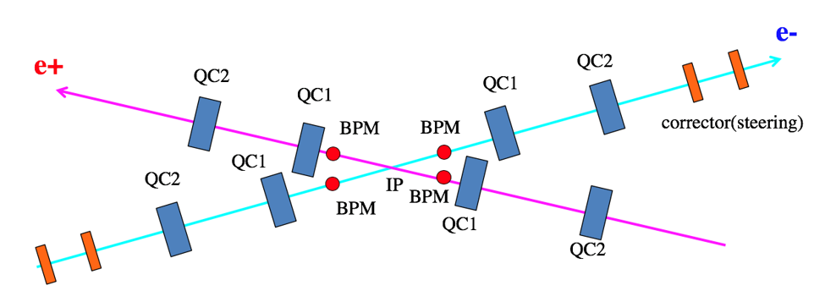
Basic idea of IP feedback system
Maintaining the beams of a two-ring collider in head-on collision requires an active feedback that moves one beam relative to the other to seek maximum luminosity.
To maximize luminosity, a feedback system adjusts the relative transverse (x, y) position and vertical angle (y') (y' is sensitive due to the small aspect ratio (y/x) of the beams at the IP) at the interaction point (IP) to find the horizontal offset that maximizes luminosity.

Slide 23
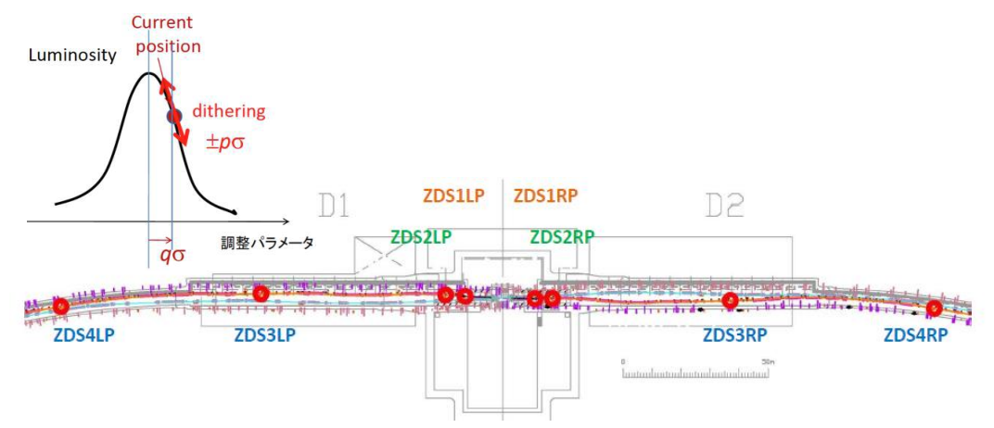

Some priliminary commissioning result of SuperKEKB
Modulate IP positions and angles with a sinusoidal signal (~60Hz) and detect the frequency and phase response of luminosity monitor using lock-in amplifiers. In the dithering feedback loop, the offset at the IP is adjusted at each feedback cycle to minimize the amplitude of the fundamental harmonics in the luminosity signal.
When the beam is dithered around the “center,” where luminosity peaks, luminosity drops on either side of the peak, giving a modulation at 2wx . When dithered off center, there is additional modulation at the fundamental.
Courtesy of Dr. M. Tobiyama

Slide 24
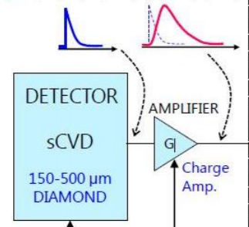
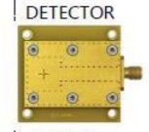

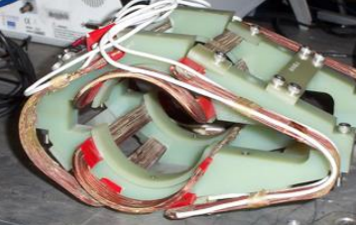
Essential study for IP feedback
1.Fast luminosity monitor
-- Radiative Bhabha scattering in the very forward direction
2. Dithering system
--A lock-in amplifier determines the luminosity component at the drive frequency. Beam offsets in all three coordinates can be measured simultaneously by using three frequencies, one per coordinate, and three lock-ins.
--Horizontal and vertical pairs of air-core coils are added at four locations surrounding the IP, on vacuum chambers for rapid field penetration. These coils do not maintain the beam position, but only drive the oscillation.

Slide 25
Summary
Bunch by bunch feedback systems are quite essential for STCF to suppress the coupled-bunch instabilities and they are under developing.
  RF processor
  Digital feedback processor
  Kickers
IP feedback is important to maximize luminosity for STCF, and it will be studied and it needs collaboration with other labs.

